Slide 1
Chapter 7. National Accounts
Link to syllabus
Notes:
Chapter 7. National Accounts

Slide 2
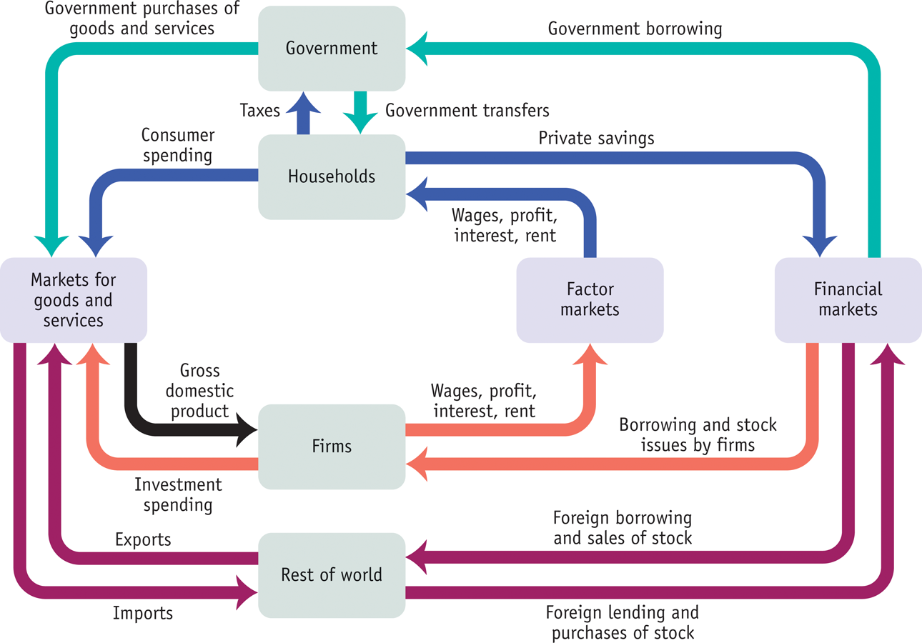
Figure 7.1 p. 189 .Circular Flow (more complicated)
Circular flow diagrams will not be included in this course.
Notes:
Figure 7.1 p. 189 .Circular Flow (more complicated)
Circular flow diagrams will not be included in this course.

Slide 3
. Value Added in a five-stage process
Different Text
Notes:
Table 6.2 Page 107 Value added in five stage production
Why national income accounting? Assess health of economy
GDP: total market value of final goods and service produced in a give year.
Avoid double/multiple counting—just do value added
Exclude financial transactions: public transfer payments, stock market
Exclude secondhand sales.
Can be measured by income or expenditures

Slide 4
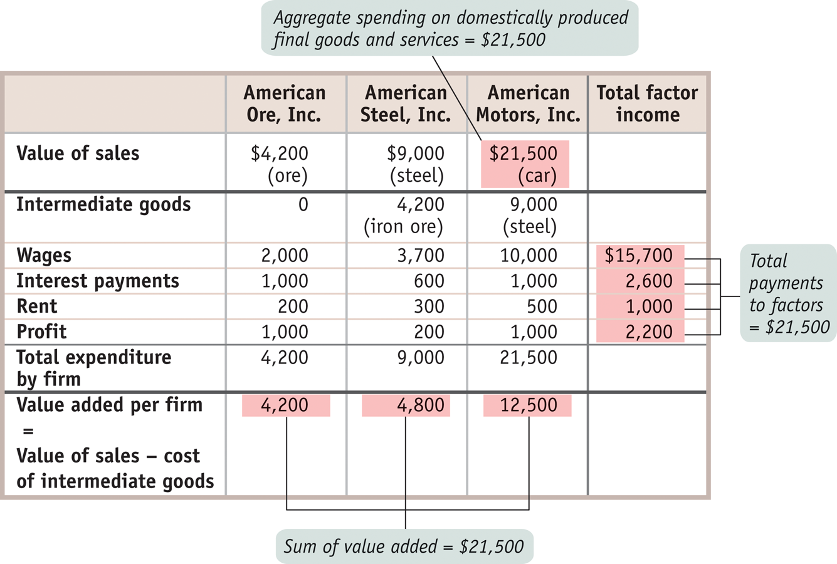
Figure 7-2 p. 192. Calculating GDP
One can calculate GDP by summing income, or by summing expenditures.
Notes:
Figure 7-2 p. 192. Calculating GDP
One can calculate GDP by summing income, or by summing expenditures.

Slide 5
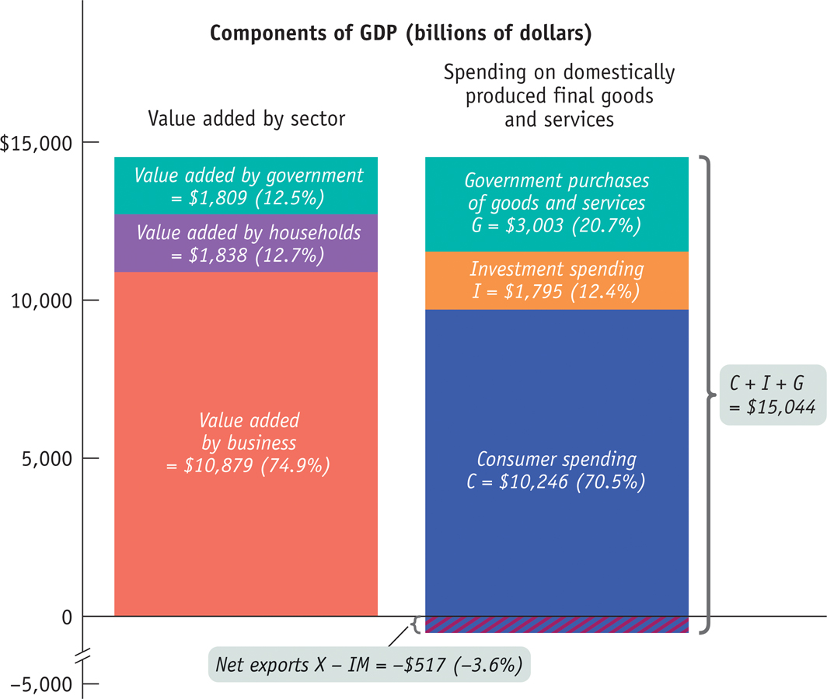
Figure 7-3 p. 195. US GDP in 2010, Income or Expenditure
Notes:
Figure 7-3 p. 195. US GDP in 2010, Income or Expenditure

Slide 6
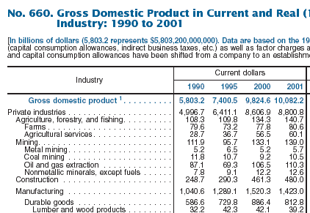
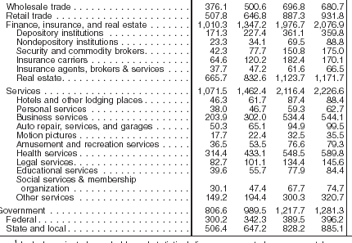
GDP by Sector: Statistical Abstract of the U.S.
Notes:
GDP by Sector

Slide 7
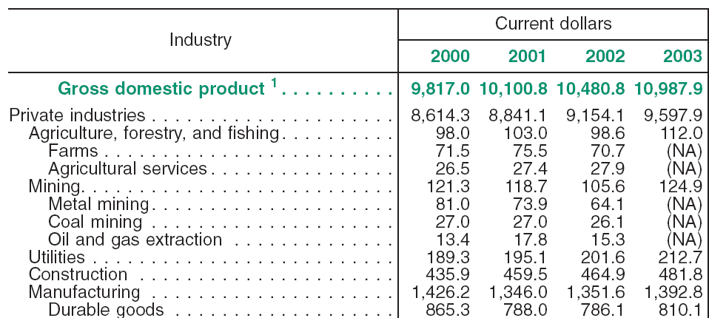
GDP, $billion
Notes:
GDP by sector

Slide 8
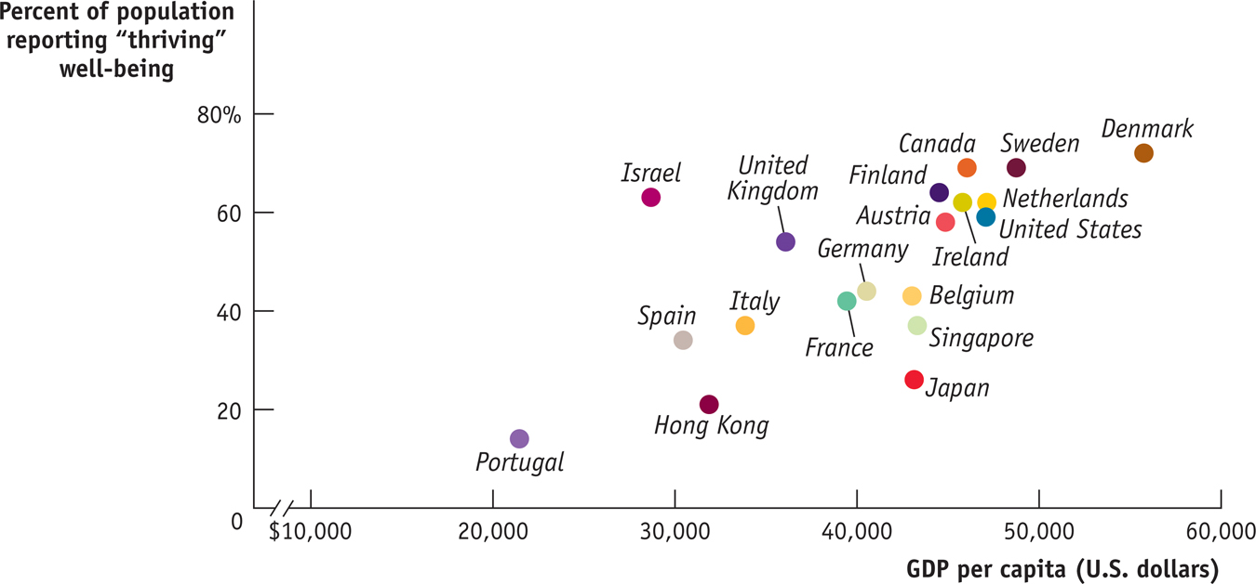
GDP and the Meaning of Life. P. 200.
Notes:
GDP and the Meaning of Life. P. 200.

Slide 9
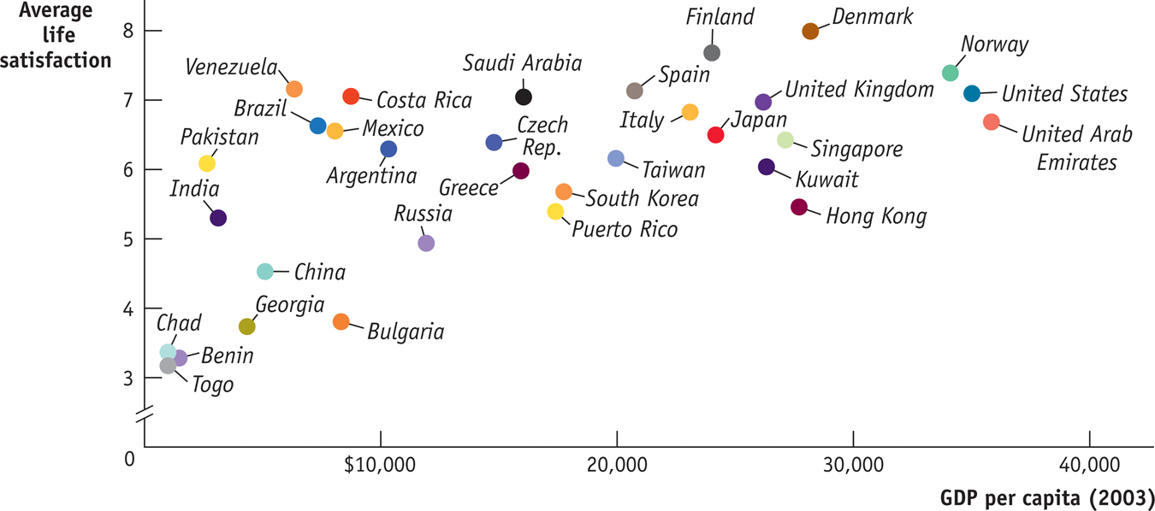
Global Comparison, p. 186. Happiness and GDP/Capita.
Previous Edition.
Point is that the inhabitants of some countries with low incomes
clearly feel worse off. Furthermore, beyond a certain point (~$10,000),
higher incomes are not associated with higher life satisfaction.
Notes:
Global Data, p. 186. Happiness and GDP/Capita
Point is that the inhabitants of some countries with low incomes
clearly feel worse off. Furthermore, beyond a certain point (~$10,000),
higher incomes are not associated with higher life satisfaction.

Slide 10
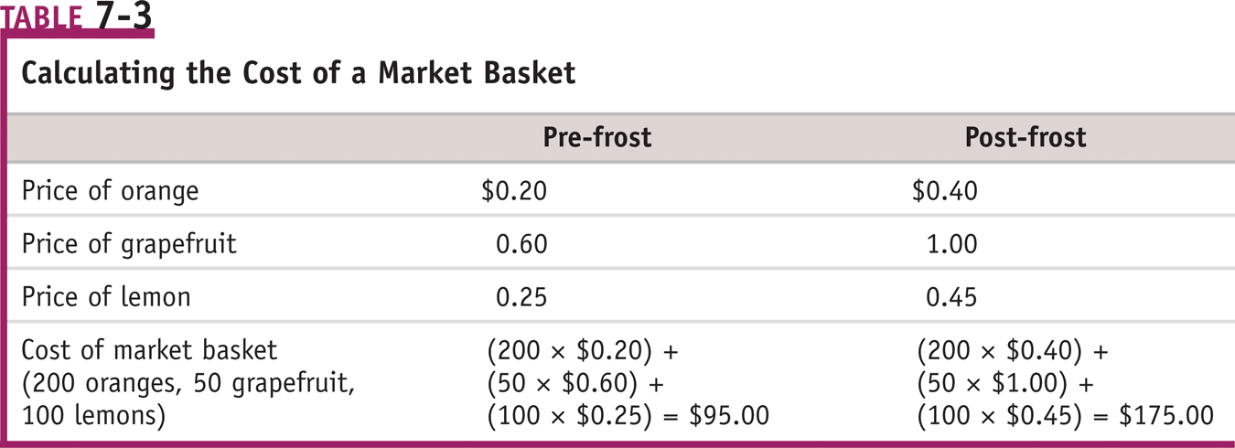
Table 7-3, p. 202. Calculating the Cost of a Market Basket
Price index = Cost of the basket in a given year/Cost of the basket
in the base year (p. 189)
So, price index for post-frost is 175/95 (x100) = 184
Notes:
Table 7-3, p. 202. Calculating the Cost of a Market Basket.

Slide 11
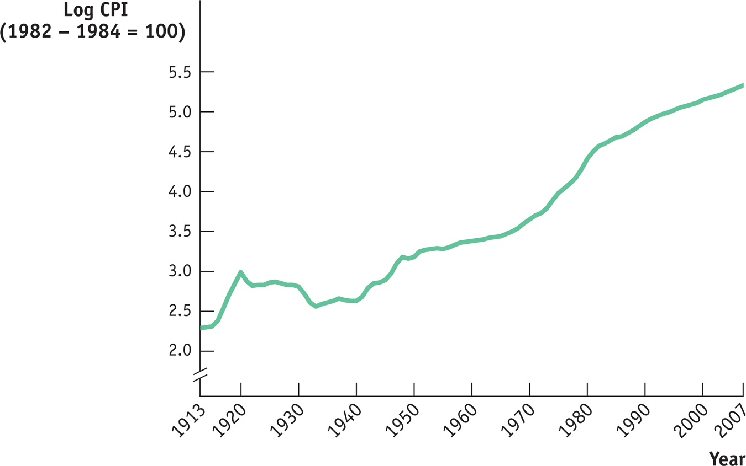
Figure 7-6, p. 204. The CPI for the US, 1913-2007
(antilog)
150
55
20
7
Notes:
Figure 7-6 p 204. The CPI for the US, 1913-2007

Slide 12
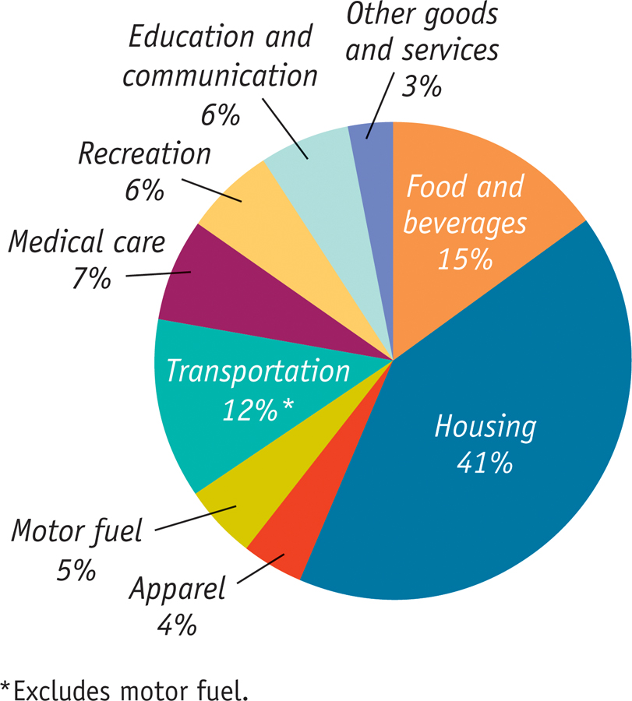
Figure 7-5 p. 203. Makeup of the Consumer Price Index
Notes:
12
Figure 7-5 p. 203. Makeup of the Consumer Price Index in the US in 2007.

Slide 13
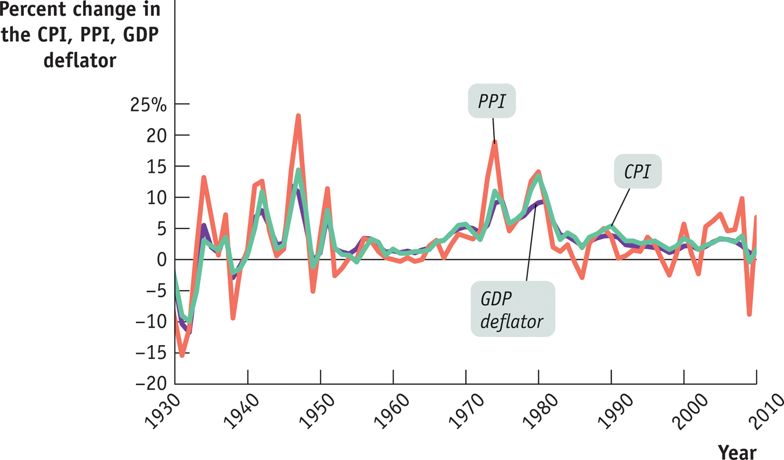
Figure 7-7 p. 205. The CPI, PPI, and GDP Deflator
Point is that these three different price indexes move mostly together.
Notes:
Figure 7-7 p. 205. The CPI, PPI, and GDP Deflator
Point is that these three different price indexes move mostly together.

Slide 14
Real GDP and Nominal GDP
Nominal GDP is the value of goods and services produced in the
economy in a given year, using the current prices of that year (p. 199) .
Real GDP is defined as the total value of all final goods and
services produced in the economy in a given year, using the prices of
the selected base year (p. 199) .
Real GDP_{t} = 100 x Nominal GDP_{t}/GDP Deflator_{t} (Page 204)
Notes:
Real GDP and Nominal GDP

Slide 15
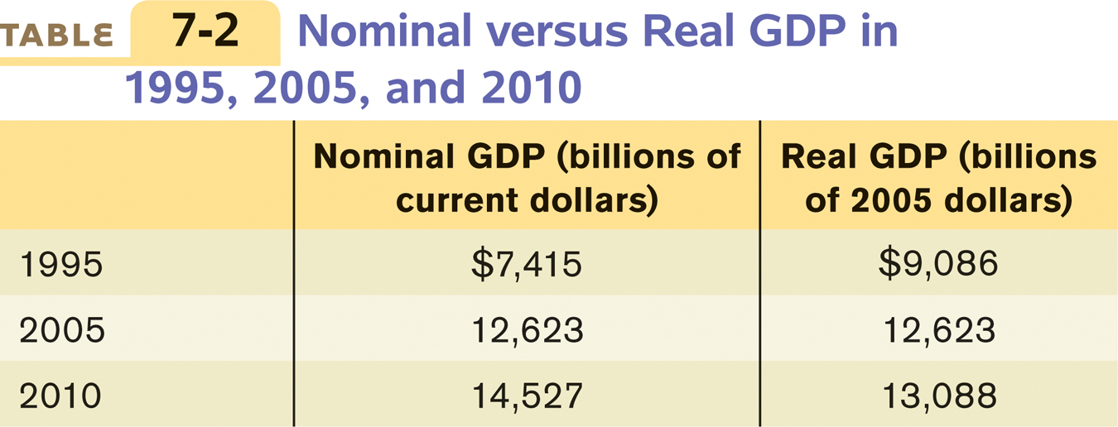
Table 7-2 p. 199. Nominal vs. Real GDP in US
Notes:
Table 7-2 p. 199. Nominal vs. Real GDP in US.
Limitation on the use of GDP as an indicator of welfare: more stuff doesn’t necessarily mean it’s used in productive ways. Old exams: issue of income distribution, leisure

Slide 16
Formulas
Definitions, p. 203
---------------------------------------------------------------------------------------
Real GDP_{t} = 100 x Nominal GDP_{t}/GDP Deflator_{t} (Page 204)
The book provides equivalent statements on page 229:
Real Income = Nominal Income/Price Level
Real Wage = Nominal Wage / Price Level
Notes:
Formulas, p. 189.
Price index = Cost of market basket in given year/Cost in base year
Inflation = (P2 – P1)/P1.
Real GDPt = Nominal GDPt/GDP Deflatort (Page 190)
The book provides similar statement on page 215:
Real Wage = Nominal Wage / Price Level
(Real Income = Nominal Income/Price level)

Slide 17
Formulas for Percentage Change (%Δ)
(Not in the text, so not on the exam.)
Calculus teaches that, if A = B/C, then %ΔA = %ΔB - %ΔC.
Apply this to economics; the real wage is W/P, so
%Δ real wage = %Δ W - %ΔP
In words, your real wage increases (%Δ real wage is positive), if
%ΔW > %ΔP, that is %ΔW > inflation.
In an individual’s personal situation, this is easy to check.
Also, a 100% COLA (p. 206) promises that %ΔW > inflation.
Notes:
Formula for Percentage Change (%Δ).
Calculus teaches that, if A = B/C, then %ΔA = %ΔB - %ΔC.
Apply this to economics; the real wage is W/P, so
%Δ real wage = %Δ W - %ΔP
In words, your real wage increases (%Δ real wage is positive), if
%ΔW > %ΔP, or:
%ΔW > inflation.
This is easy to check.
A 100% COLA promises that %ΔW > inflation.

Slide 18
Data on US Real and Nominal GDP
http://www-personal.umd.umich.edu/~mtwomey/econhelp/201files/NIPATableGDP.xls
Notes:
Link to US data on Real and Nominal GDP

Slide 19
Link to Practice Problem of Real GDP Calculations
http://www-personal.umd.umich.edu/~mtwomey/RealGDPcalc.xls
Notes:
Link to real gdp calculations.

Slide 20
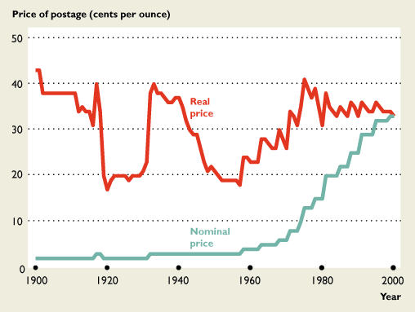
The Nominal and Real Price of a First-Class Letter
P. 164
Bade/Parkin
EYE ON THE PAST
Bat
Notes:
(from Bade/Parkin) Nominal and real price of a first class letter

Slide 21
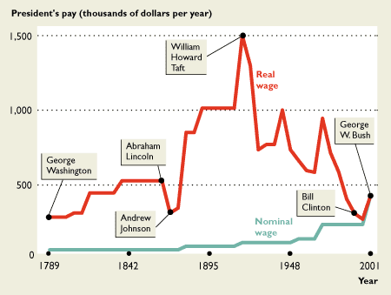
The Nominal and Real Wage Rates of Presidents of the United States
P. 166
EYE ON THE PAST
Back to list
Notes:
Nominal and real salaries of U.S. presidents
Link to my salary

Slide 22


Which movie earned the most?
Notes:
Which movie earned the most?

Slide 23
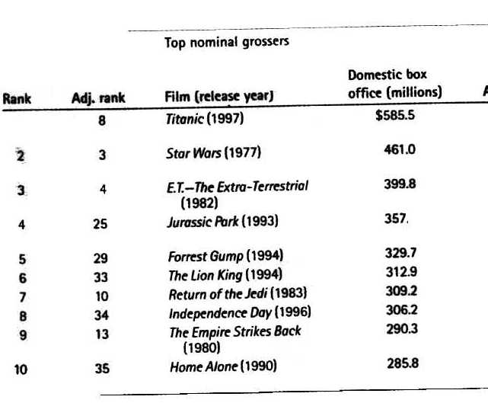
Top Nominal Movie incomes
Notes:
Movies nominal incomes

Slide 24
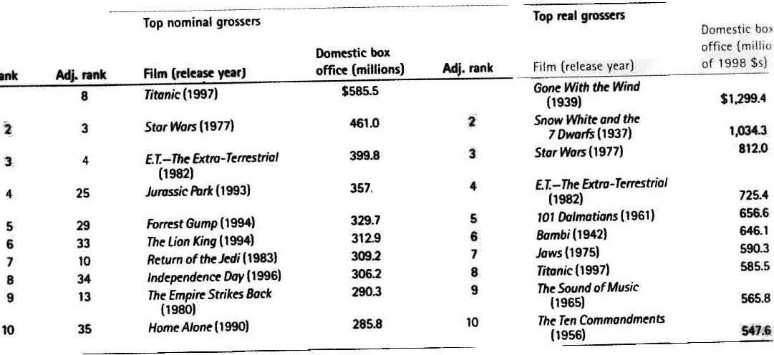
Top Real Movies
Notes:
Movies’ real incomes

Slide 25

Accounting night at the improv
“Now is the part of the show where we ask the audience to
shout out some random numbers!”
Notes:
Accounting night at the improv

Slide 26
Tuition example
Notes:
Tuition example
My real wage

Slide 27
Prof’s real wage
Notes:
Prof’s real wage
Link to MySALARY.doc

Slide 29
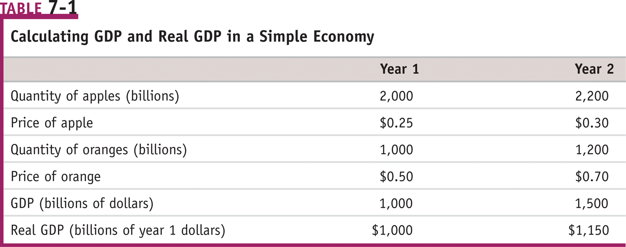
Table 7-1 p. 184. Calculating Real GDP
GDP (year 1) = 2,000 x $0.25 + 1,000 x $0.50 = $1,000
GDP (year 2, in year 2 prices) = 2,200 x $0.30 + 1,200 x $0.70 = $1,500
GDP (year 2, in year 1 prices) = 2,200 x $0.25 + 1,200 x $0.50 = $1,150
Notes:
Table 7-1 p. 184. Calculating Real GDP
GDP (year 1) = 2,000 x $0.25 + 1,000 x $0.50 = $1,000
GDP (year 2, in year 2 prices) = 2,200 x $0.30 + 1,200 x $0.70 = $1,500
GDP (year 2, in year 1 prices) = 2,200 x $0.25 + 1,200 x $0.50 = $1,150

