Slide 1
Iran
Link to syllabus
Link to newspaper article
Link to Iran Chronology
Link to https://ctools.umich.edu/portal
Notes:
Iran
Articles by Fariborz and Sarioglaham
Size of Italy, Spain and France combined.
Outline: Basic maps
History: Qajars, Reza Pahlavi, Mohammad Reza Shah Pahlavi. Mossadeq.
Revolution of Ayatollah Khomenei.
Phases of IRI
Government Structure. Current Political Figures
Judging the Islamic Regime. Why unceasing conflict between US & Iran?
Economic Analysis.
GDP, Income Distribution and Poverty.

Slide 2
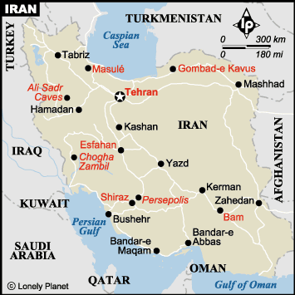
Iran Map-major cities
Notes:
Iran: Major cities

Slide 3
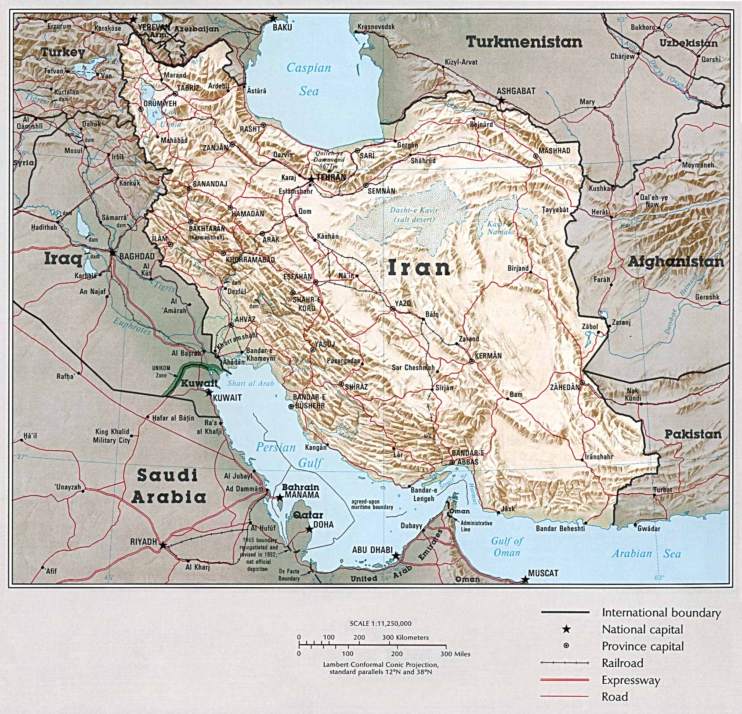
Iran: Topographical map
Notes:
Iran: topographical map

Slide 4
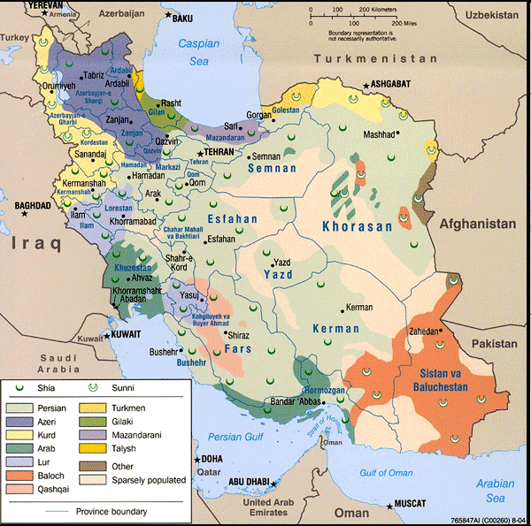
Distribution of Iran’s Population, in millions
Total ~60 million
Persians: 30
Azeris 11
Kurds 6
Gilakis 3.3
Lors 2.7
Mazandaranis 2.4
Baluchis 1.5
Bakhtiaris 1.1
Turkmens 1.0 Armenians 0.35
Source:
Encyclopedia of
the Orient
Notes:
Distribution of Iran’s Population, in millions
Persians are about half.
Source: Encyclopedia of the Orient
Islam is introduced early—by 700s. Shi’ism becomes state religion with rise of Safavids in 1501; people slowly adopt the religion.
6th century B.C., Persian empire founded by Cyrus the Great
641 A.D. Arabs incorporated Persia into Caliphate, introduced Islam
10th century, invasion by Turks
13th century, invasion by Jehghiz Khan
14th century, invasion by Timur
1502-1736 Safavid dynasty; subsequent period of decline and loss of territory
1891 Tobacco protest: first nationalist demonstrations against favoritism to foreigners
early 1900s, discovery of oil
1906-08 Constitutional era: short-lived reformist movement
1907 Anglo-Russian Entente divided Persia into spheres of influence; Britain later increases pressure to hold out Bolsheviks, maintain petroleum from Anglo-Iranian Oil Co.
1921 Coup by Reza Khan overthrowing Qajar dynasty; established Pahlevi dynasty 1925
1936 Wearing of the veil is outlawed
1941 Abdication by Reza Shah Pahlevi in favor of his son, Muhammad Reza Shah Pahlevi
1950s Shah is challenged by Prime Minister Muhammad Mussadegh who nationalized oil industry; he was ousted in 1953 with help from the CIA and British Intelligence.
1955 Iran joins Baghdad pact
1960s modernization program (a.k.a. The White Revolution; reformism from above). Land reform is promulgated, and is opposed by some religious leaders, because their estates provided them with income. Also, the secret service (SAVAK) becomes more powerful and repressive.
1963 Ayatollah Kohmeini is exiled for opposition to Shah
1970s Conflicts between Iran and Iraq over islands in the Gulf.
1979 Shah is forced to leave, and Ayatollah Ruhollah Khomeini returns from exile to lead government.
1979-81 US embassy occupied by militants, whose demand for Shah’s return was denied by his death, from cancer, in Egypt
1980-88 Iran Iraq war
1981 Revision of family law.
1985 Iran-Contra affair, with US selling arms to Iran to finance Nicaraguan contras
1989 Khomeini issues fatwa against writer Slaman Rushdie, because of his novel Satanic Verses.
1989 Khomeini dies, and is replaced by Ali Khamenei; Akbar Hashemi Rafsanjani becomes president, somewhat improving relations with US and Europe
1990 Iran condemns Iraq’s invasion of Kuwait, and outside attacks on Iraq (i.e. they remained neutral in Gulf War).
1995 US total ban on trade with Iran, alleging sponsorship of terrorism.
1997 Khatami wins presidential election, promising reformist policies.
1999 Student protests in Tehran escalate into nation-wide protests, paralleling fight between Khamenei and Khatemi
2000 Election of new Majles results in victory for reformists.
2003 Earthquake kills 40,000 in south-east
2005 Mahmoud Ahmadinejad elected in run-off, defeating Rafsanjani

Slide 5
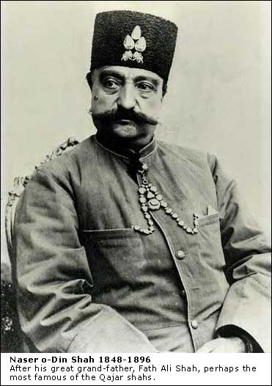
Nasser al-Din Shah
Born 1831; ruled1848-1896.
(Qajar dynasty)
Modernizer who lost zeal for
change.
Assassinated by a follower of
Jamal al-Din al-Afghani
Notes:
Nasser al-Din Shah.
1848-1896; ruled (Qajar dynasty) Modernizer who lost zeal for
change. Assassinated by a follower of Jamal al-Din al-Afghani
19th century, Qajar dynasty is failing. Country is agglomeration of tribes. Persia is in middle of conflicts between Britain and Russia. Lose tariff autonomy. Naser al-Din Shah initially wanted to modernize, visited Europe, but lost courage. In 1850s gives telegraph concession to British (who were interested in communications with India), and in 1872 general concession to Rueter for railroads, mining, industry, banking etc. Major exports were carpets, raw materials.
1891 Tobacco boycott/riots against giving monopoly of tobacco trade to a British group.
Could also note gradual de-industrialization, loss of exports, gradual displacement of native textiles.
Anti-modernism messianic movement in late 19th century, similar to Taipings, Ahmadiya in Pakistan, etc.
1906 Constitution. Attempted to shift power from Shah to Majles. Had some clerical oversight and sponsorship—important predecessor. Constitution reversed in 1908.
1908 Oil discovered. William D’Arcy had been given commission in 1901. Ango-Persian Oil Company formed.
1911 American money doctor, Morgan Shuster.
1914-18: Persia is neutral in World War 1, but—too weak to keep out foreign powers-- becomes a battle ground, where the oil of the country was the goal. Was British protectorate for a time after war.

Slide 6
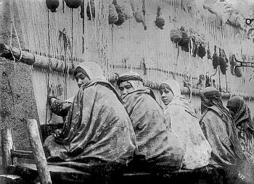
Children Carpet Weavers, ~1880
Source: Sevruguin and the Persian Image
Notes:
Children Weavers
From Iran-va=jahan web site

Slide 7
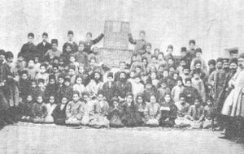
Education in Iran (Persia)
Source: iran-va-jahan
“In 1900, there were only 21 Dabestan or modern primary schools in Iran. Prior to their introduction, vehemently opposed by the mullahs, Maktabs or religious schools run by mullahs were the norm.”
Notes:
In 1900, there were only 21 Dabestan or modern primary schools in Iran. Prior to their introduction, vehemently opposed by the mullahs, Maktabs or religious schools run by mullahs were the norm.

Slide 8
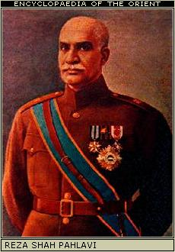
Reza Shah Pahlavi
1878-1944
Shah (emperor) 1925-41
Born into military family. Charismatic
leader. With British help, he overthrew
previous government.
Described as following policies
similar to Ataturk (more secular,
no religious clothing). Later,
established close ties to Germany
in effort to counterbalance British.
Forced into exile in 1941; succeeded by
his son.
Notes:
Reza Shah Pahlavi
1878-1944
Shah (emperor) 1925-41
Born into military family. With British help, he overthrew
previous government. Is described as following policies similar to Ataturk (more secular, no religious clothing). Established close ties to Germany in effort to counterbalance British. Dies in exile; succeeded by son.
Is described as following policies similar to Ataturk -more secular government, no religious clothing. Didn’t have Ataturk’s common touch, was less familiar with Europe. [Note chronological parallels].
During 1930s, established close ties to Germany in effort to counterbalance British. British troops invade Iran, leading to his abdication. Dies in exile; succeeded by son.
1935 name of country changed from Persia to Iran.

Slide 9
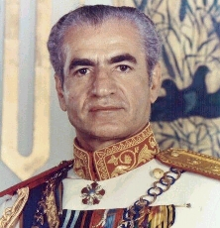
Mohammad Reza Shah Pahlavi
1919-1980 Shah (emperor) 1941-79.
Educated in Switzerland.
Inherited rule at age 22.
In 1951-53, tension with P.M. Mohammad Mosaddeq, who attempted to nationalize British petroleum companies. The British and
CIA helped Shah back to power, and he remained loyal to U.S.
Was exiled, & replaced by Khomeini in 1979. Died of cancer the next year .
He is often described as ‘refined’ or just simply ‘weak’ and insecure. Marked contrast to his father, who was an authoritarian military type.
Notes:
1919-1980
Shah (emperor) 1941-79
Inherited rule from his father at early age. In 1951-53, tension with Mohammad Mosaddeq, who attempted to nationalize British petroleum cos.
CIA helps Shah back to power, and he remained loyal to U.S.
Was exiled, & replaced by Khomeini in 1979.
Said to be weak willed. Studied in Switzerland. Three wives, first was Egyptian princess.

Slide 10
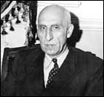
Dr. Mohammad Mossadeq
1882-1967, Prime Minister 1951-53
Father was Finance Minister under Qajars.
Educated in England and Switzerland. Became
Deputy Finance Minister in 1917.
Nationalist who took help from Tudeh, (Marxist
Party). As Prime Minister, he attempted to
nationalize British-owned oil companies.
Was eventually overthrown in 1953 with
help from the CIA.
Allowed to live the rest of his life under house
arrest near Teheran.
Link to bio of Mossadeq
Notes:
Mossadeq.
Father was Finance Minister under Qajars. Educated in England and Switzerland. Became Deputy Finance Minister in 1917. Prime Minister who attempted to nationalize British-owned oil companies. Nationalist who took help from Tudeh, Marxist
party. Was eventually overthrown in 1953 with help from the CIA. Allowed to live under house arrest near
Teheran.
1951-53, tension with Prime Minister Mohammad Mosaddeq, who attempted to nationalize Anglo-Iranian Petroleum Company. 1949 election in Majlis was over foreign control of oil. Issue became foreign share of petroleum profits - 50/50. CIA helps Shah back to power, and he remained loyal to U.S.
1955, Iran joined the Baghdad Pact, which brought together the "northern tier" (anti-USSR) countries of Iraq, Turkey, and Pakistan in an alliance that included Britain, with the United States serving as a supporter of the pact but not a full member. The pact was renamed the Central Treaty Organization--CENTO--after Iraq's withdrawal in 1958-and is described as a pretext under which US funneled aid to Iran.
1963 White revolution: land reform, nationalization of forests, profit sharing in industry, vote for women, infrastructural and development projects. Land reform resisted by some religious elements, whose income came from land endowments (waqf). Led to riots, exile of Ayatollah Khomeini. Marxist party (Tudeh) also prohibited after 1963 riots.
Subsequently, the Shah made greater use of SAVAK to control.
1970s minor border skirmishes with Iraq.
1979, Shah was exiled, & replaced by Khomeini in 1980. Shah went first to Panama, eventually to Egypt, where he died of cancer. His son lives in US, ready to return if called.

Slide 11
Shah M. Reza Pahlavi’s Modernization Policies
Often referred to as the White Revolution (i.e., bloodless); 1963-
Economics:
Agrarian reform weakened the traditional landowning class, as well as challenging
the land and revenues of the clergy.
Is often depicted as hostile to Bazaari class, whom the Shah viewed as backward.
Reversed the nationalization of oil companies
Pushed education, rural infrastructure, roads, etc.
Profit sharing in industry.
Social:
Gave vote to women, while allowing some veiling (which father had forbidden)
Politics:
Hostile to Tudeh ( ~ Communist) Party, and to religious – Ayatollah Khomeini
International:
Friendly toward Israel, monarchies of Saudi A., Morocco, Jordan. Sadat
Baghdad Pact (anti-USSR)
The Shah’s regime is described as increasingly corrupt and authoritarian.
Notes:
Shah M. Reza Pahlavi’s Modernization Policies.
Often referred to as the White Revolution (i.e., bloodless); 1963-
Economics:
Agrarian reform weakened the traditional landowning class, as well as challenging
the land and revenues of the clergy
Is often depicted as hostile to Bazaari class, whom the Shah viewed as backward
Reversed the nationalization of oil companies
Pushed education, rural infrastructure, roads, etc.
Social:
Gave vote to women, while allowing some veiling (which father had forbidden)
Politics:
Hostile to Tudeh ( ~ Communist) Party, and to religious – Ayatollah Khomeini
International:
Friendly toward Israel, monarchies of Saudi A., Morocco, Jordan. Sadat
The Shah’s regime is described as increasingly corrupt and authoritarian.

Slide 12
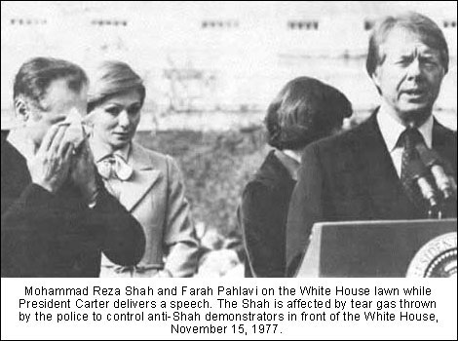
Revolution 1
Notes:
Revolution 1

Slide 13
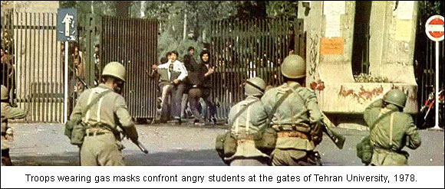
Revolution 1a
Notes:
Revolution 1a

Slide 14
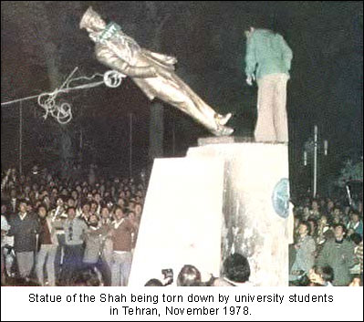
Revolution 2
Notes:
vRevolution 2

Slide 15
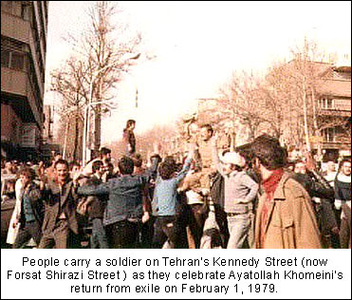
Revolution 3
Notes:
Revolution 3

Slide 16
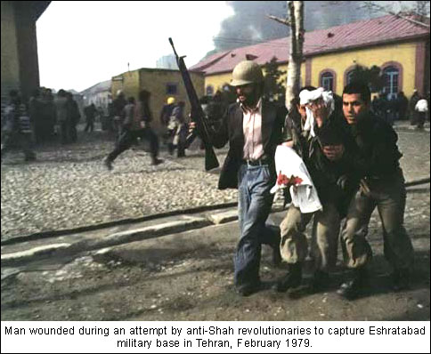
Revolution 5
Notes:
Revolution 5

Slide 17
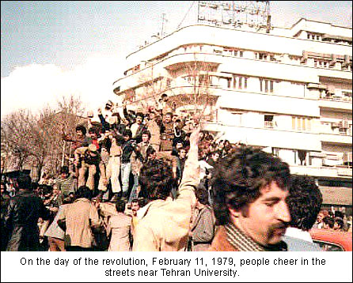
Revolution 6
Notes:
Revolution 6
Why overthrown? Autocratic, increasingly so. SAVAK. Concentration of wealth. Pro-US. President Carter had made an issue of human rights. Unable to produce changes he sought. Student movement was strong. Shah was ill; could have been replaced.
Contradictions between Shah’s ideals and his actions.
Selling out to foreigners.
(Absolute) monarchy was/is obsolete
No political parties had been allowed to grow, so religious movement evolved.
Rentier economies don’t function well.

Slide 18
Why Was the Shah Overthrown?
Autocratic, increasingly so. SAVAK.
Concentration of wealth. Pro-US. But President Carter chose to
make an issue of human rights. Shah was unable to produce
changes he himself sought. Student movement was strong.
Contradictions between Shah’s ideals and his actions.
Selling out to foreigners.
Shah was ill; could have been replaced.
(Absolute) monarchy was/is obsolete
Rentier economies don’t function well.
Not so much secular/religious gap.
Notes:
Why Was the Shah Overthrown?
Autocratic, increasingly so. SAVAK.
Concentration of wealth. Pro-US. President Carter had made an
issue of human rights. Unable to produce changes he sought. Student movement was strong.
Shah was ill; could have been replaced.
Contradictions between Shah’s ideals and his actions.
Selling out to foreigners.
(Absolute) monarchy was/is obsolete
Rentier economies don’t function well

Slide 19
Why Islamic Revolution?
There was going to be a “revolution,” as a reaction against the Shah. So why was it Isalmic?
Weakness of political system, “the left”
No political parties had been allowed to grow, thereby leaving a space for a religious movement to dominate. Ayatollah Khomeini was the natural leader
The revolution was a “Nativist response to Western cultural domination, led by lay intellectuals, in which Islam initially played a secondary role.” [Boroujerdi: Iranian Intellectuals and the West 1996]
“Occidentalism”—orientalism in reverse. “Westoxification” [Gharbzadigi]
Notes:
Why Islamic Revolution?
There was going to be a revolution, as a reaction against the Shah.
So why was it Isalmic?
Weakness of political system, “the left”
No political parties had been allowed to grow, thereby leaving a space for a religious movement to dominate. Ayatollah Khomeini was the natural leader
The revolution was a “Nativist response to Western cultural domination, led by lay intellectuals, in which Islam initially played a secondary role.” [Boroujerdi: Iranian Intellectuals and the West 1996]
“Occidentalism”—orientalism in reverse. “Westoxification” [Gharbzadigi]

Slide 20
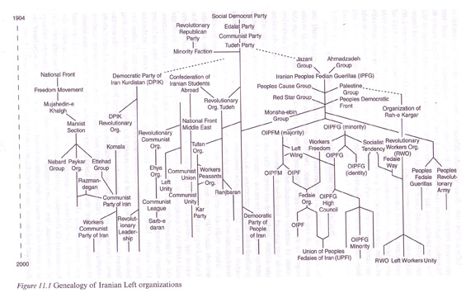
The Genealogy of Iranian Left organizations.
Source: Reformers and Revolutionaries in Modern Iran p. 255
Notes:
The Genealogy of Iranian Left organizations.
Source: Reformers and Revolutionaries in Modern Iran p. 255
Post Shah period: one says of Islamic Revolution of Iran
Three phases:
1) Revolutionary Phase (few months of 1979-1980)
2) Domination by Khomeini, Iran-Iraq War (1980-89)
3) Post Khomeini
Events around 1980:
Nationalization of 70% of capital, 2/3 of GDP. Foreigners were eventually re-imbursed. Massive capital flight. ”Structural involution.”
Price controls. Subsidization of firms. Clerical control of (charitable) foundations, ‘banyads’ taking over Shah’s wealth.
Was a period of radicalization, of growing definition of direction of the Iranian revolution. New constitution approved in 1979.
Key political event was the students swarm US embassy in 1979, and Khomeini does not reject this. Bazragan resigns. 444 days of hostage; they were released as Ronald Reagan was sworn in as President.

Slide 21
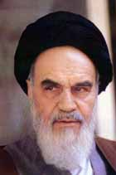
Ayatollah Ruhollah Khomeini
1902-1989
‘Supreme Leader’ of Iran 1979-89
Born into a family of clerics and landowners.
Religious teacher in Qom, was arrested and exiled in 1963 for opposing land reform and women’s emancipation, as well as attacking regime’s corruption. Went to Turkey, Iraq, and ultimately to Paris, from where he influenced events in Iran.
One of his sons was killed by SAVAK in 1977.
Proposed, and got approval for, system of Vilayat al-faqih, and was Iran’s first ‘Supreme Leader.’
After the collapse of the Shah’s monarchy, Khomeini dismissed the importance of economics in the new order, remarking that, “Iran’s Islamic Revolution was not about the price of melons.”
Notes:
Ayatollah Khomeini
1902-1989
Leader of Iran 1979-89
Born into a family of clerics and landowners.
Religious teacher in Qom, was arrested and exiled in 1963 for opposing land reform and women’s emancipation, as well
as attacking regime’s corruption. Went to Turkey, Iraq, and ultimately to Paris, from where he influenced events in Iran. Sent cassettes of his speeches, which were passed around.
One of his sons was killed by SAVAK in 1977
Had developed over the years the idea, and wrote book entitled Islamic government (Velayat-e Faqih) which outlined the institutions that were subsequently adopted.
He had also been critical of the clergy, as being too accomodationist. Returns in 1980.
Reasons for Khomeini’s popularity include: 1) uncompromising hostility towards the Shah, since 1963; 2) rhetoric that was both anti-imperialistic and populist; 3) simple lifestyle and language; 4) religious status.
Why Islamic Revolution?
Reaction against the Shah
Nativist response to Western cultural domination, led by lay intellectuals, in which Islam initially played a secondary role. [Boroujerdi: Iranian Intellectuals and the West 1996] “Occidentalism”—orientalism in reverse. “Westoxification” [Gharbzadigi]
Importance of Ayatollah Khomeini as central force. He used pan-Islamism to de-emphasize Shia/Sunni differences. His movement succeeded where Islamic Brotherhood and Jama-e’Islami did not.
Note importance of his example for subsequent religious events, rather as Nasser in 1950s/60s. His conflicts with other Shia ayatollahs.. Khosi in Iraq, mentor of Ali al-Sistani.
Weakness of political system, “the left”

Slide 22
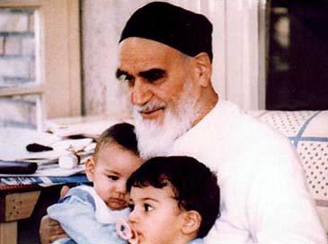
Ayatollah Khomeini

Slide 23
Reasons for Khomeini’s Popularity
Uncompromising hostility towards the Shah
Shah was secularist, elitist, insecure, inflexible, authoritarian
and his modernization policies did not bring enough visible success
Khomeini was the leading opposition figure.
Khomeini’s rhetoric was both anti-imperialist and populist.
Simple lifestyle and language.
Religious status
Even though some thought of him as an upstart
Note that outsiders – both in US & Europe – underestimated his influence
Notes:
Reasons for Khomeini’s popularity
Uncompromising hostility towards the Shah
Shah was elitist, insecure, inflexible, became more authoritarian
His modernization policies did not bear enough visible success
Rhetoric that was both anti-imperialist and populist
Simple lifestyle and language
Religious status
Even though some thought of him as an upstart

Slide 24
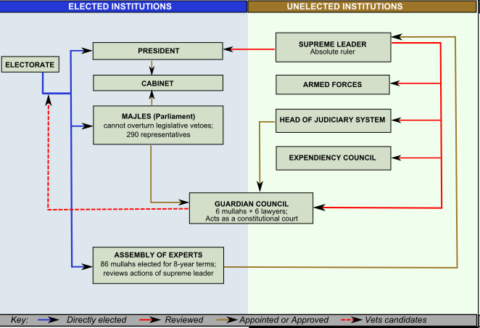
Iran’s Government
Illustration from Wikipedia
Dominated by clerics - mt
Source: Wikipedia article on Iran.
Notes:
Iran’s Government
Guardian Council is composed of six Islamic jurists, selected by the Supreme Leader of Iran, and six jurists elected by the Majlis from candidates nominated indirectly by the Supreme Leader. It is charged with interpreting the Constitution of Iran, supervising elections of, and approving of candidates to, the Assembly of Experts, the President and the Majlis (Parliament)
Expediency Council appointed by the Supreme Leader, intermediates conflicts between the Majlis and the Guardian Council.

Slide 25
Iran’s Supreme Leaders and Presidents
Supreme Leaders:
Ayatollah Ruhollah
Khomeini 1979 - 1989
Ali Khamenei 1989 - present
Presidents:
Banisadr 1980-81
Khamenei 1981-89
Rafsanjani 1989-97
Khatami 1997-2005
Ahmadinejad 2005 -2013
Rouhani 2013-
The position of Prime Minister of Iran was abolished in 1989;
its last occupant was Mir-Hossein Mousavi.
Notes:
Iran’s Supreme Leaders and Presidents
Supreme Leaders:
Ayatollah Ruhollah
Khomeini 1979 - 1989
Ali Khamenei 1989 - present
Presidents:
Banisadr 1980-81
Khamenei 1981-89
Rafsanjani 1989-97
Khatami 1997-2005
Ahmadinejad 2005 - present

Slide 26
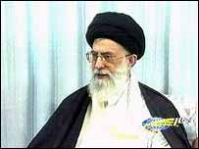
Ayatollah Ali Khamenei
President 1981-1989
Supreme Leader 1989-
Iran’s spiritual leader and highest authority-- “Supreme Leader” or Leader of the Islamic Revolution (Wali Faqih)
Successor of Ayatollah Khomenei
Viewed as “conservative,” hostile to US; opposed 2003 invasion of Iraq.
Critical of pro-reform student protests in mid-2003.
Some assert that he is absorbing control of the secular, non-religious
aspects of the country’s government.
Generally described as having favored Ahmadinejad over Mousavi in
2009 presidential election, but has since split with Ahmadinejad.
Notes:
Ayatollah Ali Khameinei
President 1981-1989
Supreme Leader 1989-
Iran’s spiritual leader and highest authority-- “Supreme Leader” or Leader of the Islamic Revolution (Wali Faqih) Successor of Ayatollah Khomenei
Viewed as “conservative,” hostile to US; opposed 2003 invasion of Iraq.
Critical of pro-reform student protests in mid-2003.
1999 Protests Democracy, anti-clerical. [discussed in Current History article]
2002 December--2003 June. Student protests against privatization of University of Teheran, raise tuition. Also against repressive policies of Islamic Republic, “Death to Khamenei”. Some support from Teheran’s middle classes. Right wing paramilitaries attacked students viciously. Ayatollah Khamenei accused students of being American mercenaries. (Juan Cole, The Nation July 14, 2003). Can be argued that there are debates inside Shi’a religious groups, “the reform of Islam” with implications for national welfare.

Slide 27
Iran’s political map, Safshekan and Sabet (2010)
Islamic Revolutionary Party (under Ayatollah R.Khomeini – 1980s)
Islamic Left Islamic Right – dominated by clergy
‘Reformers’ ‘Principalists ‘ [a.k.a. ’Conservatives’]
Influence - in Parliament (Majlis) Influence - in the executive branch
Policies: Populist Policies: Laissez Faire
Socialist Bazaar - Clergy alliance
Ag Reform Socially conservative
ISI Politically authoritarian
Anti-Imperialist
Moussavi Khamenei
Karrubi
‘Green Movement’
Independent Clergy: ‘Neo-Principalists’
Rafsanjani led by Ahmadinejad
Sadeq Larijani linked with IRGC, Bonyads
Nadeq Nouri Becoming anti-clerical, and militarizing -
Rouhani(?) hence Praetorian
Other Independents: Suggestion that there is an age factor,
Ali Larijani as these are younger, yearning
Ghalibaf (mayor of Tehran) for times of Khomeini.
Self-described as technocrats and pragmatists,
Finding inspiration of Chinese model of nationalism
and economic and tech. development.
Follow Ayatollah Mesbah-Yazdi
‘
Notes:
Iran’s political map, Safshekan and Sabet (2010)

Slide 28
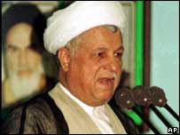
Akbar Hashemi Rafsanjani
President 1989-1997
Speaker of the Majlis 1980-89
Wealthy pistachio grower.
Until recently was President of the
Expediency Council.
Had been seen as a “progressive;” but is
more traditional than Khatami.
Lost 2005 election to Ahmadinejad.
Notes:
Akbar Hashemi Rafsanjani.
President 1989-1997
Speaker of the Majlis 1980-89
Currently President of the Expediency
Council
Had been seen as a “progressive;” but is
more traditional than Khatami.
Lost 2005 election to Ahmadinejad.

Slide 29
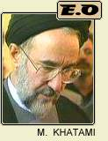
Mohammed Khatami
Born 1943
President of Iran 1997-2005.
Father was an important religious leader; he
studied Islamic sciences in Qom.
Leader of Islamic Center of Hamburg, Germany
Returned to Iran after victory of Revolution.
Elected President in 1997, running as a
moderate reformist, working for slow, incremental
change. Efforts to establish link with US were
rebuffed by Pres. Bush. Reform efforts were not
very successful, and he was succeeded by a
fire-brand populist.
Notes:
Mohammed Khatami.
Born 1943
President of Iran 1997-2005.
Father was an important religious leader; he
studied Islamic sciences in Qom.
Leader of Islamic Center of Hamburg, Germany
Returned to Iran after victory of Revolution.
Elected President in 1997, running as a
moderate reformist, working for slow, incremental
change. Evidently, was not real successful, and was
succeeded by a fire-brand populist.

Slide 30
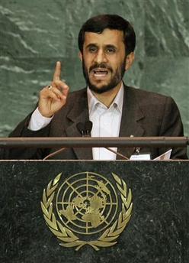
Mahmud Ahmadinejad
Born 1956, son of a blacksmith. Raised in Tehran. Has a Ph.D. in engineering
Appointed Mayor of Tehran 2003,
Elected President 2005- 2013.
Described as a religious conservative,
and a populist. Campaign slogan was
“We shall put the fruits of oil wealth
on the ordinary person’s table.”
Known for making strong anti-Israel and anti-American statements. Suggestion that he strives for independence from religious establishment, and that he lost to Khamenei the battle for influence.
Notes:
Mahmud Ahmadinejad
Born 1956, son of a blacksmith
Raised in Tehran
Has a Ph.D. in engineering
Appointed Mayor of Tehran 2003
President 2005-
Described as a religious conservative,
a populist. Known for making strong
anti-Israel and anti-American
Statements. Suggestion that he pushes
for independence from religious
establishment.
Parliamentary elections in 2004. Presidential elections in 2005. Voter turnouts have been falling.
Judging Islamic Regime:
Family Planning
Immediate change was moves judged hostile to women:
Divorce, jobs. Then moderated, significant support for family planning.
Economic Policies: Country has stagnated; people do not feel that benefits of oil have reached them. Technocrats criticize lack of care and upkeep of oil. Some believe that clergy is keeping benefits of oil. [See below]
Agrarian Reform
1982 after many debates, law passed. Rejected in 1983 by Council of Guardians. Reconsidered a milder version in 1985, also rejected. 1986 an even milder version was accepted.
In those votes, the clerics did not vote uniformly.
Politics: Democracy-staying within Constitution
Women’s issues Subject to significant criticism—recently gave Nobel Peace Prize to a female Lawyer
Suggestion that look at analysis of “ruling clergy” in Baktiari and Vaziri article. Functional gridlock.
Why unceasing conflict between US and Iran?
Historical background—Iran squeezed between two expanding empires, Britain and Russia/USSR. Oil wealth
Specific events relating to US and Shah, (and Mossadeq and oil)
Ayatollah Khomeini: hatred for US/Shah, (takeover of embassy, Iran/contra, US support of Iraq, US hostility to Muslim theocracy)
Post-Khomeini: exporting of terrorism; US embargoes, axis of evil; nuclear power; vested interests in both countries.
No natural support for Iran inside US—not oil industries.
Strategic geographical considerations. US neo-cons and political industrial complex.
Analysis of Economic Results and Policies.
Economic policies are difficult to judge in war economy
Slow Job Creation.
Poverty down.
Inflation increased, lots of price controls
Non-petroleum sector is growing, slowly.
Unsatisfactory investment and industrial growth.
Poor support for the national oil company Oil sector is weaker than before—overproduction, lack of maintenance, increased internal demand, no new reserves. Could use new FDI and explorations.
Little debt.
Nomani & Behdad (p. 36): involution “fervent search for a populist-statist Islamic utopia” 1980-88. Followed by a period of economic restructuring, a la IMF and World Bank. Bloated state economic sector. Multiple exchange rates were eventually unified. Bonyads benefited from special privileges.
Karshenas and Pesaran emphasize negative effects of exchange rate controls. Need for planning but inability. “Inflexible fiscal machinery of Shah’s era. Exhaustion of Shah’s ISI, especially in context of Dutch disease. Rentier nature. Inability of export oriented sector to develop.
Agriculture:
Land Reform: Major mobilizations of peasants by “radicals”, versus return of land taken by Shah.
Issues were “dead land”, land acquired unjustly (but centuries earlier), inefficient, large holdings shared out.
Shakoori describes creation of Ministry of Jihad, Village Councils, cooperatives. Concludes (p. 98) “..most agricultural and rural policies initiated after the revolution were politically motivated, and once the short-term political objectives had been attained most projects, such as the service centers, the village councils, the provisions laid down in the Land Reform Act and even the mosha cooperatives were either abandoned or left to fade away.”

Slide 31
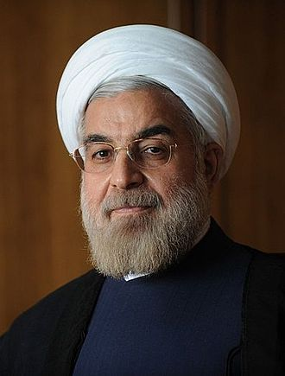
Hassan Rouhani, 1948-
Cleric with status of Mujtahid.
Had been on the Assembly of Experts, a member of the Expediency Council; was
Deputy speaker of the Parliament, and headed Iran’s nuclear negotiating team.
Elected President in 2013.
Viewed in the west as a moderate.
Has facilitated beginning conversations between Iran, the US,
and European powers, on nuclear energy, Syria, and many other topics.
Notes:
Hassan Rouhani, 1948- Cleric with status of Mujtahid.
Has been on the Assembly of Experts, a member of the Expediency Council; was
Deputy speaker of the Parliament, and headed Iran’s nuclear negotiating team.
Elected President in 2013.
Viewed in the west as a moderate.

Slide 32
Mullahs

Slide 33
Bazaari
May also want to control
trade, discourage diversification.
Nikou asserts that the Shah
wanted to replace them, and they
were active in his overthrow.
Notes:
Bazaaris.

Slide 34
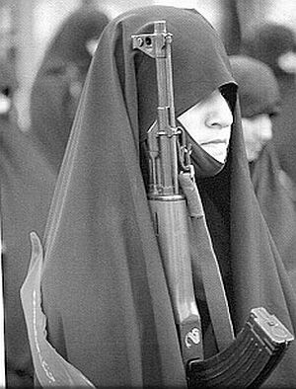
Iranian Women: Images from before and after the Islamic Revolution
Pictures from web site
Iran -va-jahan
Notes:
Iranian Women: Images from before and after the Islamic Revolution
Pictures from web site Iran -va-jahan

Slide 35
Analysis of IRI’s Economic Policies, and Results. (i)
Economic policies are difficult to judge in war economy of 1980s
Some food production is subsidized; consumption even more so
Slow Job Creation.
Poverty down.
Inflation increased, lots of price controls
Non-petroleum sector is growing, slowly.
Unsatisfactory investment and industrial growth.
Little debt.
Islamic Banking enforced, may be related to slow growth
Inadequate support for the national oil company. Oil sector is weaker than before—overproduction, lack of maintenance, increased internal demand, no new reserves. Could use new FDI and explorations.
US-led boycott has caused significant economic pressure (against Japan and India on oil and gas, trade & financial pressure).
Oil consumption is subsidized-one of the cheapest in world.
Some assert that clergy is keeping significant benefits from oil sector.
Notes:
Economic policies are difficult to judge in war economy
Some food production is subsidized; consumption also.
Slow Job Creation.
Poverty down.
Inflation increased, lots of price controls
Non-petroleum sector is growing, slowly.
Unsatisfactory investment and industrial growth.
Little debt
Inadequate support for the national oil company Oil sector is weaker than before—overproduction, lack of maintenance, increased internal demand, no new reserves. Could use new FDI and explorations. Significant US economic pressure (against Japan and India on oil and gas, trade boycott & financial pressure). Oil consumption is subsidized-one of the cheapest in world. Some assert that clergy is keeping benefits of oil.

Slide 36
Analysis of IRI’s Economic Policies and Results. (ii)
Nomani & Behdad (p. 34-36) structural involution: More than a decline in output and deindustrialization, but a ‘shriveling of capitalist relations of production, the expansion of petty commodity production with gargantuan increase in redundant service employment… obstructing the accummulation process.
Resulting from the “fervent search for a populist-statist Islamic utopia” 1980-88. Followed by a period of economic restructuring, a la IMF and World Bank. Bloated state economic sector. Multiple exchange rates were eventually unified.
Ghadar and many others criticize ‘economic coup’ by Bonyads, IRGC.
Karshenas and Pesaran emphasize negative effects of exchange rate controls. Need for planning but inability. Inflexible fiscal machinery of Shah’s era. Exhaustion of Shah’s ISI, especially in context of Dutch disease. Rentier nature. Inability of export oriented sector to develop.
Notes:
Analysis of IRI’s Economic Policies and Results. ii
Nomani & Behdad (p. 36): structural involution More than a decline in output and deindustrialization, but a ‘shriveling of capitalist relations of production, the expansion of petty commodity production with gargantuan increase in redundant service employment… obstructing the acumulation process.
“fervent search for a populist-statist Islamic utopia” 1980-88. Followed by a period of economic restructuring, a la IMF and World Bank. Bloated state economic sector. Multiple exchange rates were eventually unified.
Karshenas and Pesaran emphasize negative effects of exchange rate controls. Need for planning but inability. “Inflexible fiscal machinery of Shah’s era. Exhaustion of Shah’s ISI, especially in context of Dutch disease. Rentier nature. Inability of export oriented sector to develop.

Slide 37
Analysis of IRI’s Economic Policies and Results. (iii)
Land Reform: Major mobilizations of peasants by “radicals”, opposed to return of land taken by Shah. Issues were “dead land”, land acquired unjustly (but centuries earlier), inefficient, large holdings shared out. 1982 after many debates, law passed. Rejected in 1983 by the Council of Guardians. Reconsidered a milder version in 1985, also rejected. In 1986 an even milder version was finally accepted.
In those votes, the clerics did not vote uniformly; some observers view opposition by the clerics as protecting their own self-interest.
Shakoori describes creation of IRI’s Ministry of Jihad, Village Councils, cooperatives. Concludes (p. 98) “..most agricultural and rural policies initiated after the revolution were politically motivated, and once the short-term political objectives had been attained most projects, such as the service centers, the village councils, the provisions laid down in the Land Reform Act and even the mosha cooperatives were either abandoned or left to fade away.”
Subsequently, stability of (private) land tenure has led to increased ag. production.
mt has not seen an analysis of the impact of the US led boycott.
Notes:
Land Reform: Major mobilizations of peasants by “radicals”, opposed to return of land taken by Shah. Issues were “dead land”, land acquired unjustly (but centuries earlier), inefficient, large holdings shared out.
Shakoori describes creation of IRI’s Ministry of Jihad, Village Councils, cooperatives. Concludes (p. 98) “..most agricultural and rural policies initiated after the revolution were politically motivated, and once the short-term political objectives had been attained most projects, such as the service centers, the village councils, the provisions laid down in the Land Reform Act and even the mosha cooperatives were either abandoned or left to fade away.”
Stability of (private) land tenure has led to increased production.

Slide 38
Iran’s Plan to Phase Out Subsidies Brings Frenzied Debate
December 2, 2009
New York Times By ROBERT F. WORTH
BEIRUT, Lebanon — The outside world may be focused on Iran’s intensifying
confrontation with the West over its nuclear program. But at home, Iranians are
more concerned with an ambitious and risky new effort to overhaul the country’s
troubled economy.
If it goes awry, the plan to phase out Iran’s system of state subsidies, which has
existed for decades, could profoundly destabilize the government of Mahmoud
Ahmadinejad, who has aggressively championed change. But it could also help
wean Iran from its dependence on foreign gasoline and insulate the economy
from new sanctions — which are a strong possibility if Iran continues to defy Western
pressure over its nuclear program.
There is widespread agreement that selling everyday goods at far below market
prices, which costs the Iranian government an estimated $100 billion a year,
makes little economic sense. It encourages overconsumption of gasoline and other
products, discourages domestic production and makes Iran more dependent on
imports, economists say. The subsidies are also regressive, because the rich pay
the same artificially low prices as the poor and consume far more. And they
encourage smuggling. Previous governments tried to eliminate subsidies and build a more dynamic, market-oriented economy, but retreated in the face of popular pressure. President Ahmadinejad —
Notes:
Iran’s Plan to Phase Out Subsidies Brings Frenzied Debate

Slide 39
Bonyads
Charitable religious foundations in Iran, ~ waqf
Do not pay taxes, receive gov’t subsidies, little government control;
are essentially responsible only to the Supreme Leader.
Very little publicly accessible data
Estimates are that the Bonyads control 20% of the country’s
economy
Have increased in power since the revolution in 1979
Associated with the IRGC and certain mullahs
Astan Quds Razavi (Imam Reza shrine Foundation: in
Moshhad), with $15 billion in assets (2003)
It is asserted that these groups are cash rich, enabling them to
take advantage of privatizations, and strengthen their
monopolistic hold on sectors of the private economy
‘Turf-fights’ with the National Iranian Oil Company
Notes:
Bonyads
Charitable religious foundations in Iran, ~ waqf
Do not pay taxes, receive gov’t subsidies, little government control;
are essentially responsible only to the Supreme Leader.
Very little publicly accessible data
Estimates are that the Bonyads control 20% of the country’s
economy
Have increased in power since the revolution in 1979
Associated with the IRGC and certain mullahs
Astan Quds Razavi (Imam Reza shrine Foundation: in
Moshhad), with $15 billion in assets (2003)
It is asserted that these groups are cash rich, enabling them to
take advantage of privatizations, and strengthen their
monopolistic hold on sectors of the private economy
‘Turf-fights’ with the National Iranian Oil Company

Slide 40
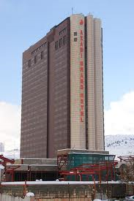
Bonyad Mostazafan & Janbazan
(Foundation for the Oppressed and Disabled)
One of the largest Bonyad (charitable
organizations, ar. Waqf), said to be the largest commercial enterprise in Iran after the oil co.
Initially founded as the Pahlavi Foundation,
which was taken over after the Revolution.
With over 200,000 employees, it owns and operates approximately 350 subsidiary and affiliate companies in numerous industries including agriculture, industry, transportation, and tourism.
Assets worth tens of billions of US dollars.
Azadi Grand Hotel (ex- Hyatt) in Tehran,
owned by Bonyad Janbazan
& Mostazafan
Notes:
Azadi Grand Hotel (ex- Hyatt) in Tehran, owned by Bonyad Janbazan & Mostazafan

Slide 41
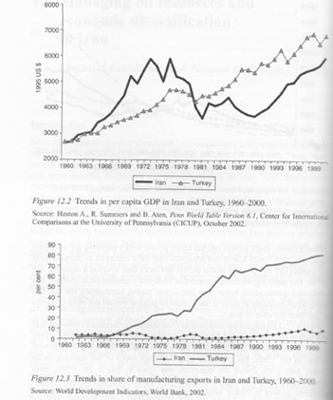
Comparisons Iran/Turkey
The authors present a similarly negative comparison with
Malaysia
Source: chapter by Karshenas and Hakimian,
in Katouzian and Shahidi (eds.)
Iran in the 21st Century
Notes:
Comparisons Iran/Turkey. Source: chapter by Karshenas and Hakimian,
in Katouzian and Shahidi (eds.) Iran in the 21st Century
The authors present a similarly negative comparison with Malaysia

Slide 42
Judging Socio/cultural impact of the IRI Regime
Women’s issues Subject to significant criticism from overseas commentators,
although some later moderation on issues such as divorce & work.
(The Nobel Peace Prize was recently given to a female Human Rights lawyer).
On Family Planning, immediate policy was pro-natal, then moderated, and now
significant support for family planning.
Politics: Democracy-staying within Constitution, which is described as a
theocracy. Some judge this as non-ideological flexibility. 2009 election criticized.
Interesting analysis of “ruling clergy” in Baktiari and Vaziri article, which
describes “functional gridlock” of the regime, due to internal divisions.
Religious influence on the economy (mentioned above):
Islamic banking:
Bonyads (charities), have become economic conglomerates
benefiting from special privileges.
Agrarian Reform
Growth of military/IRGC is not directly related to religion
Notes:
Judging Socio-Cultural aspect of the Republic of Iran’s Regime
Women’s issues Subject to significant criticism, although some later moderation on issues such as divorce & work. The Nobel Peace Prize was recently given to a female Lawyer [see below]
Family Planning
Immediate change was pro-natal, then moderated, and now
significant support for family planning.
Agrarian Reform 1982 after many debates, law passed. Rejected in 1983 by Council of Guardians. Reconsidered a milder version in 1985, also rejected. 1986 an even milder version was accepted.
In those votes, the clerics did not vote uniformly. Stability of (private) land tenure has led to increased production.
Politics: Democracy-staying within Constitution. Some view this as non-ideological flexibility.
Interesting analysis of “ruling clergy” in Baktiari and Vaziri article, which describes “Functional gridlock” of theocracy.

Slide 43
Why unceasing conflict between US and Iran? (i) - not religion per se
Historical background breeding nationalism—Iran squeezed
Oil wealth also invites nationalism
Specific events relating to the Shah’s relation to US:
Shah not accepted as ruler by Iranians
Wasteful monarchy
Mossadeq nationalized oil, overthrown by CIA
Shah allowed/encouraged excessive military expenditures
Motives relating to Ayatollah Khomeini & US:
His hatred for Shah and his supporter, the US
Takeover of US embassy, complicated by Iran/contra affair
US support of Iraq against Iran
US hostility to Muslim theocracy.
Notes:
Why unceasing conflict between US and Iran?
Historical background breeding nationalism—Iran squeezed
Oil wealth also invites nationalism
Specific events relating to US and Shah:
Shah not accepted as ruler by Iranians
Wasteful monarchy
Mossadeq nationalized oil, overthrown by CIA
Shah allowed/encouraged excessive military expenditures
Motives relating to Ayatollah Khomeini & US:
His hatred for Shah and his supporter, the US
Takeover of US embassy, complicated by Iran/contra
US support of Iraq against Iran
US hostility to Muslim theocracy.

Slide 44
Why unceasing conflict between US and Iran? (ii)
Post-Khomeini:
Iran (& Syria) military support for US foes Hamas, Hizbullah, Iraq
US embargoes of Iranian businesses, trade, finance, etc.
Bush’s speech “axis of evil”
Iran’s nuclear power
Vested interests in both countries.
Politicians have a visible foe
No natural support for Iran inside US—not in oil industries.
Strategic geographical considerations.
Strengthening of Iran is unintended result of invasion of Iraq
US neo-cons and political-industrial complex.
Who will be regional power, Iran or Israel/Saudi Arabia?
Notes:
Post-Khomeini:
Iran (& Syria) military support for US foes Hamas, Hizbullah, Iraq
US embargoes of Iranian businesses, trade, finance, etc.
Bush’s speech “axis of evil”
Iran’s nuclear power
Vested interests in both countries.
Politicians have a visible foe
No natural support for Iran inside US—not in oil industries.
Strategic geographical considerations.
US neo-cons and political-industrial complex.
Who will be regional power, Iran or Israel

Slide 46
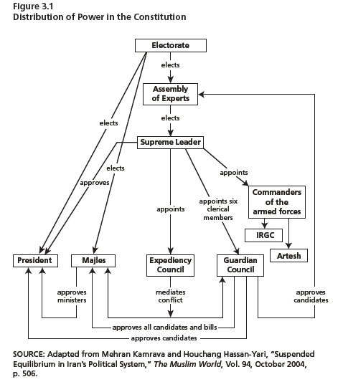
Iran: Distribution of Constitutional Power
Source: Thaler et al., (2010) “Mullahs,
Guards and Bonyads,” Rand
Notes:
Iran: Distribution of Constitutional Power

Slide 47
Link to article on 1999 student protest
Notes:
Link to article on 1999 student protest

Slide 48
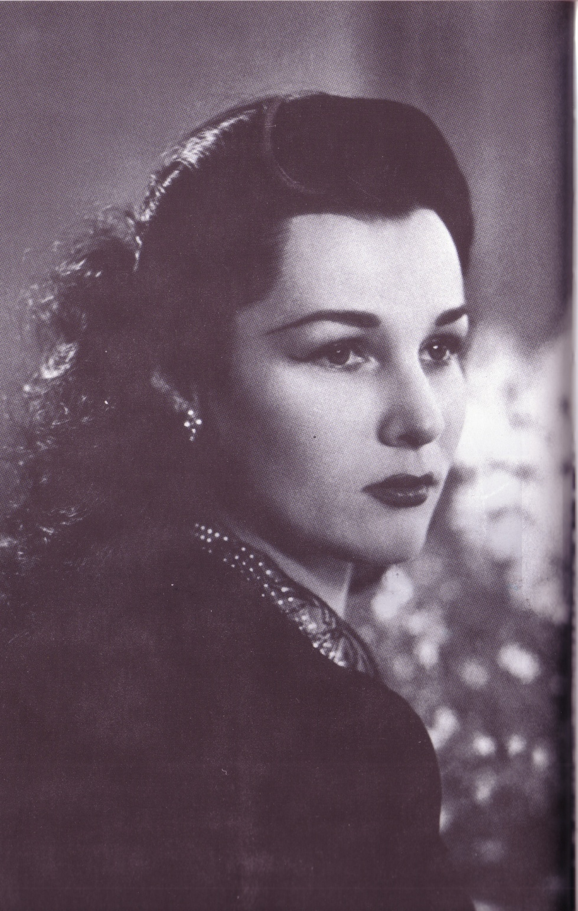
Princess Fawzia
Sister of King Faruk of Egypt
About the time she married
the Shah of Iran
Notes:
Princess Fawzia Sister of King Faruk of Egypt
About the time she married the Shah of Iran
Shah described as weak willed—father was strong personality. Studied in Switzerland. Married three times, first to the Egyptian princess Fawzia. His second wife no children.

Slide 49
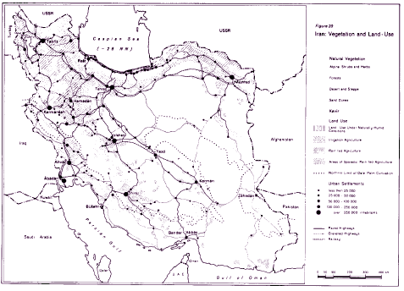
Iran: Vegetation and Land Use
Source: Encyclopaedia Iranica, article on agriculture
Notes:
Iran: Vegetation and Land Use.
Source: Encyclopaedia Iranica, article on agriculture

Slide 50
Resilience 1
Notes:
Resilience 1

Slide 51
Resilience 4

Slide 52
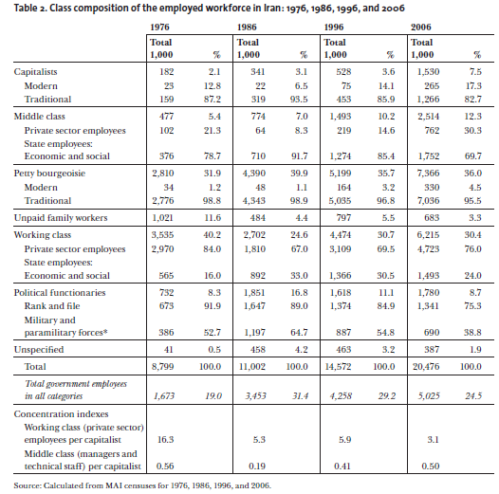
Class Composition in Iran, 1976-2006
Source: Behdad and Nomani (2009) “What a Revolution! Thirty Years of Social Class Reshuffling in Iran,”
Comparative Studies of South Asia, Africa and the Middle East 29:1
Notes:
Class Composition in Iran, 1976-2006
Source: Behdad and Nomani (2009) “What a Revolution! Thirty Years of Social Class Reshuffling in Iran,”
Comparative Studies of South Asia, Africa and the Middle East 29:1

Slide 53
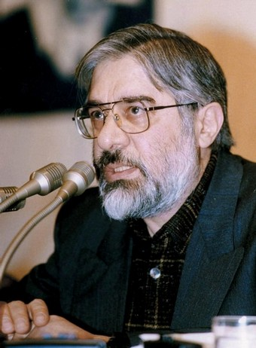
Mir Hossein Mousavi
1941 –
Architect by training
Prime Minister 1981-89, also
Minister of Foreign Affairs
Described as the ‘Reformist
Candidate’ in June, 2009 elections. The announced results of that election – giving victory to Ahmadinejad - were
widely doubted, and led to massive protests. His wife, Zahra Rahnavard,
is a leading political activist and cultural figure. They are under house arrest.
Leader of the ‘Green Movement.’
Notes:
Mir Hosseini Mousavi
1941 –
Architect by training
Prime Minister 1981-89, also
Minister of Foreign Affairs
Described as the Reformist
candidate in June, 2009
elections.

Slide 54
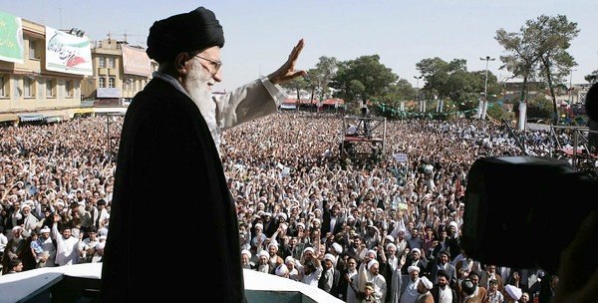
Los Angeles Times October 30, 2010
Iran's supreme leader demands support of clerics. Ayatollah Ali Khamenei warns the leaders of
the Shiite Muslim clergy if they embrace Western ideals or oppose President Ahmadinejad's hard-line government, the Islamic Republic could collapse.
--
Iran's supreme leader wrapped up an unprecedented 10-day visit to the Iranian seminary city of Qom on Friday that was widely seen as an attempt to bolster support among those in a clerical establishment either indifferent or hostile to his conservative agenda. In a series of meetings, Ayatollah Ali Khamenei warned turbaned leaders of the Shiite Muslim clergy to avoid becoming excessively enamored of unorthodox, reformist and Western ideas and too unsupportive of the hard-line government of President Mahmoud Ahmadinejad, who has long aroused suspicion among Iran's clerical old guard.

Slide 55
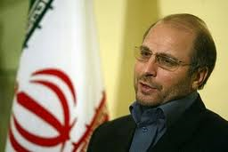
Mohammmad Bagher Ghalibaf
Born 1961 near Mashhad,in eastern Iran.
Active in Iran-Iraq War, and with Basiji.
Became Chief of Police for IRI.
Ran for President in 2005. Later that year
he was selected as Mayor of Tehran.
Generally viewed as success as Mayor. Has broad support among
conservatives. Had expressed support for Obama’s call for dialogue
between Iran and US.
Rising young star.
Lost to Rouhani in 2013 presidential elections.
Notes:
M
Born 1961 near Mashhad,in eastern Iran.
Active in Iran-Iraq War, and with Basiji.
Became Chief of Police for IRI.
Ran for President in 2005. Later that year
Was selected as Mayor of Tehran.
ohammmad Bagher Ghalibaf
Generally viewed as success as Mayor. Has broad support among
conservatives. Had expressed support for Obama’s call for dialogue
between Iran and US.
Rising young star.

Slide 56
Ahmadinejad vs. Khamenei in the headlines
See Farhang Jahanpour’s guest column in Juan Cole’s blog Informed Comment, May 8, 2011

Slide 57
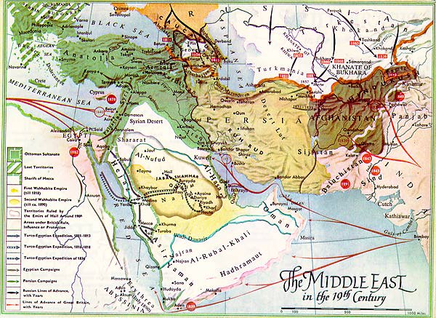
Map of 19th Century Middle East
Notes:
Map of Middle East in 19th century

Slide 58
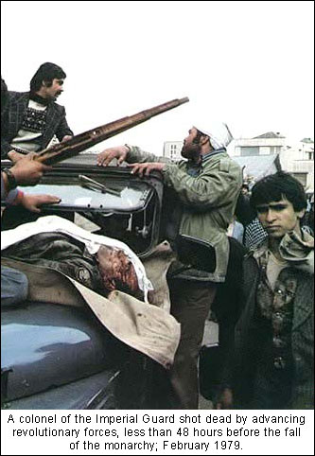
Revolution 4
Notes:
Revolution 4

