Slide 1
Jordan, Syria, Lebanon
Link to syllabus
Link to https://ctools.umich.edu/portal
Link to WDI
Notes:
Jordan, Syria, Lebanon

Slide 2
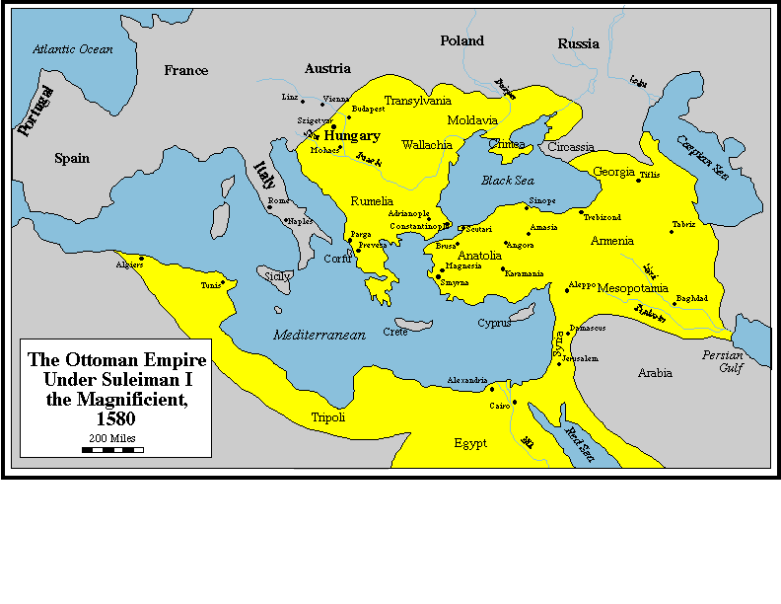
Ottoman Empire under Suleiman the Magnificent, 1580
Notes:
Ottoman Empire under Suleiman the Magnificent, 1580

Slide 3
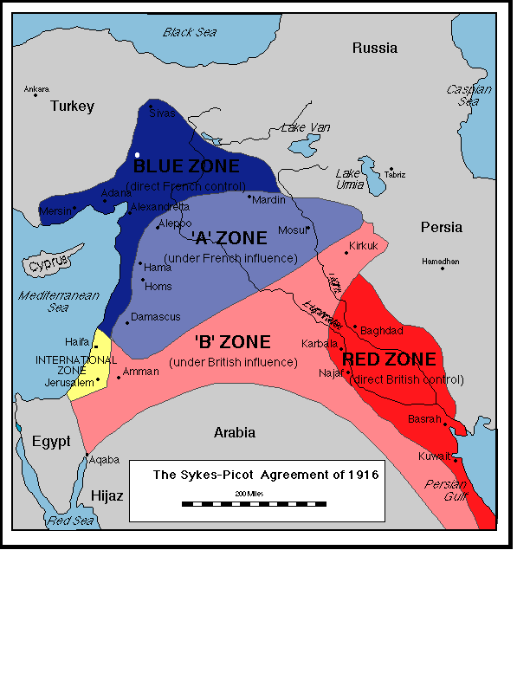
Sykes-Picot: Zones
Secret accord between
France and Britain for
setting out spheres of
influence in the
ex-Ottoman Empire.
Frustrated goal of a pan-
Arab nation.
Was discovered by
Bolsheviks in Czar’s
archives.
Notes:
Sykes-Picot zone

Slide 4
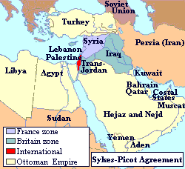
Sykes-Picot Agreement 1916
Secret accord between
France and Britain for
setting out spheres of
influence in the
ex-Ottoman Empire.
Frustrated goal of a pan-
Arab nation.
Was discovered by
Bolsheviks in Czar’s
archives.
Notes:
Sykes-Picot Agreement--map

Slide 5
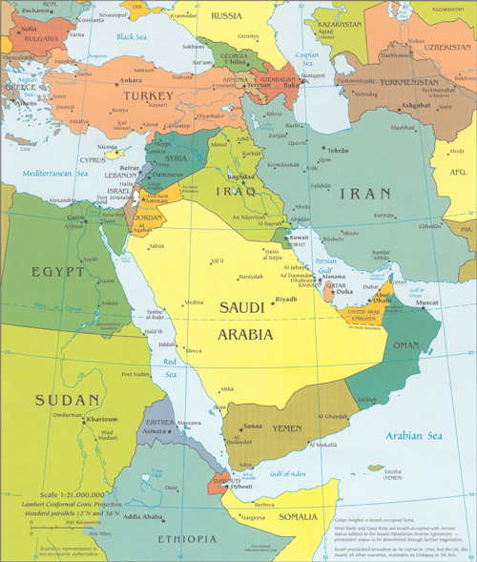

Slide 6
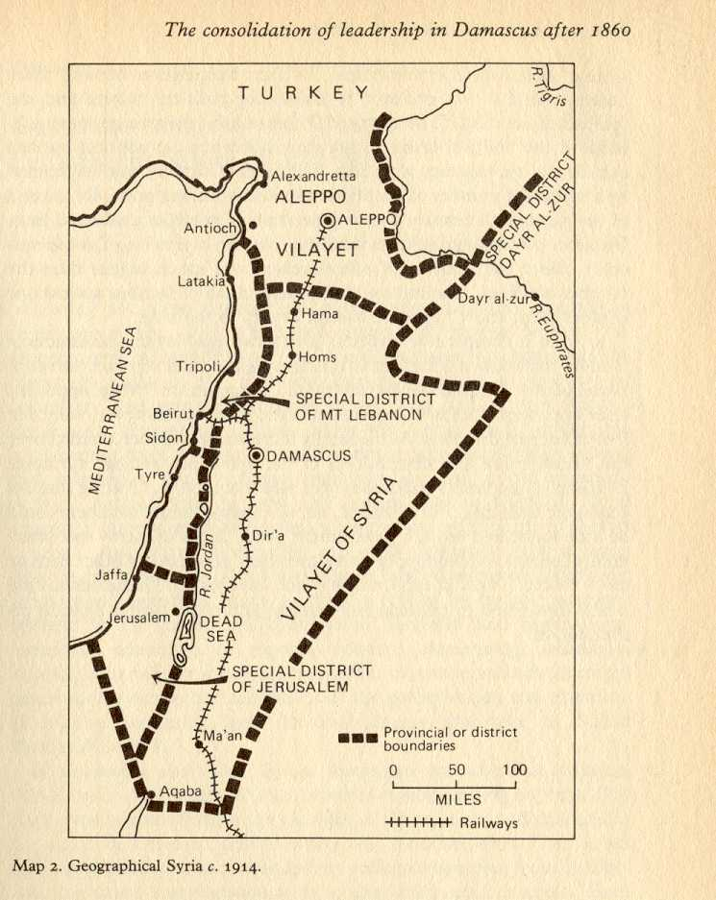
“Greater” Syria in 1914
Encompassing Syria, Lebanon,
Jordan, Israel, West Bank & Gaza.
Note that Aleppo is separate.
Source: Khoury: Urban notables
and Arab Nationalism
Notes:
Syria in 1914

Slide 7
Jordan
Notes:
Jordan

Slide 8
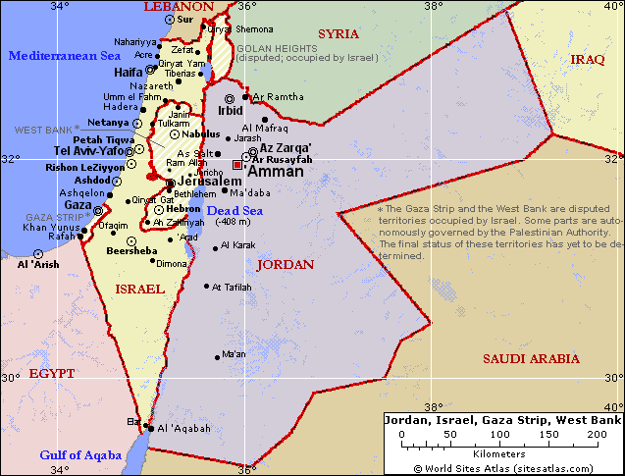
Jordan, Israel, West Bank &Gaza
Notes:
Jordan, Israel and the West Bank&Gaza

Slide 9
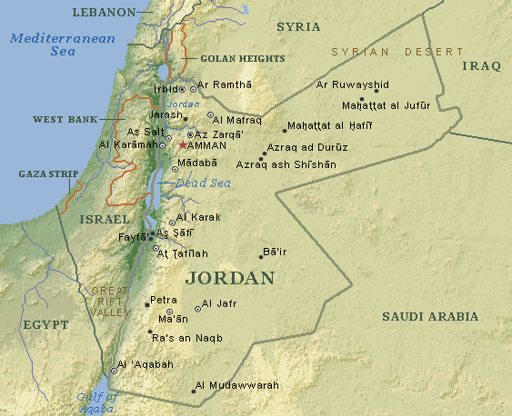
Map of Jordan
Notes:
Map of Jordan

Slide 10
Jordan’s Population ~ 2005, by Ethnic groups
Arabs 5,700,000 97.0%
Palestinians 3,100,000 52.5%
Jordanians 1,850,000 31.5%
Bedouins 750,000 13.0%
Circassians, Armenians, Iranians, Turkmen, Kurds, and
others ~200,000 3%
Total 5,900,000
Temporary (Refugees)
Iraqis 450,000 to 500,000 7.8%
Source: Encyclopedia of the Orient, (without citations)
Notes:
Jordan’s population, by ethnic groups

Slide 11
Jordan Chronology
http://www-personal.umd.umich.edu/~mtwomey/econhelp/444files/Jordan_Dates.docx
Notes:
Jordan Chronology
1516 Ottoman control
1920 British Mandate; Abdullah Ibn Hussein is head of country (initially called Transjordan)
1946 Independence
1948 War accompanying establishment of State of Israel leads to influx of refugees, Jordanian control of West Bank.
1951 Abdullah assassinated by a Palestinian; his grandson, Hussein, becomes king in 1953
1957 British finish withdrawal of troops
1967 Arab-Israeli war; Jordan loses the West Bank
1970 internal strife (civil war) between Palestinians and Hussein/Jordanian Army
1974 King Hussein renounces claims to West Bank, and allows PLO to organize there
1979 Jordan opposes Egypt-Israel peace treaty
1989, 93 Parliamentary elections. Islamist parties boycotted election of 1997
1994 Jordan signs peace treaty with Israel
1999 King Hussein dies, succeeded by his son Abdullah
2001 Jordan signs Free Trade Agreement with the U.S.
2005 Suicide bombs in major hotels in Amman.

Slide 12
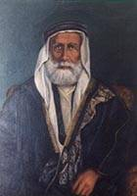
Sharif Hussein
1853-1931
Was Sharif/king/ruler of Mecca
Lost his territory in Arabia to
Ibn Saud. His sons ruled Jordan
and Iraq.
Notes:
Sharif Hussein
1853-1931
Lost his territory in Arabia to Ibn Saud. His sons ruled Jordan and Iraq.

Slide 13
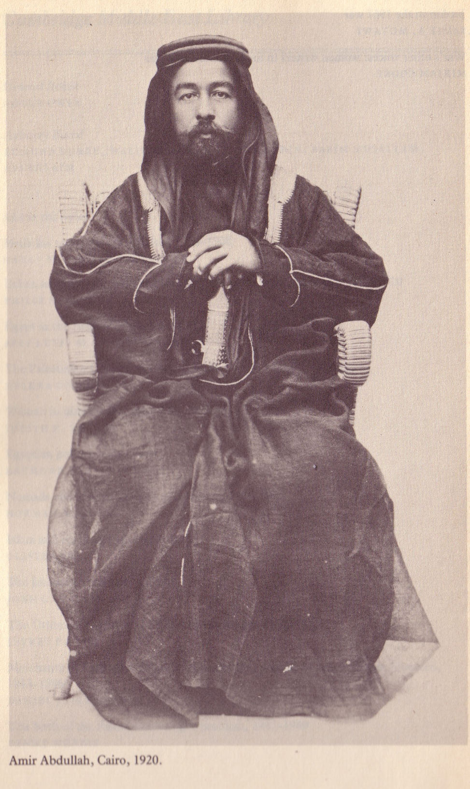
Emir/King Abdullah I
1882 – 1951
Ruled 1921-1951
Son of Sharif Hussein. Born in Mecca,
raised in Istanbul. Leader of the Arab Revolt
against Ottomans.
Head of the newly formed (Trans-)Jordan
in 1921. His “Arab Legion” secured East
Jerusalem in the 1948 war with Israel.
Assassinated by a lone (Palestinian)
gunner at al Asqa Mosque in Jerusalem.
A “Pan-Arabist,” he was out-maneuvered
by the British and French in post WWI
negotiations.
Source: Wilson, King Abdullah, Britain and the making of Jordan
Notes:
King Abdullah
1882 – 1951
Ruled 1921-1951
Born in Mecca to a prominent
Hashemite family, raised in Istanbul.
Leader of the Arab Revolt against Ottomans.
Head of the newly formed (Trans-)Jordan in 1921. His “Arab Legion” secured East Jerusalem in 1948 war with Israel.
Assassinated by a lone (Palestinian) gunner at Al Asqa Mosque. A “Pan-Arabist,” he was out-maneuvered by the British and French in post WWI negotiations.

Slide 14
Why Arab (esp. Palestinian) hostility towards King Abdullah?
Outsider from Saudi Arabia, imposed by Britain.
He had collaborated with British during his 1930s land
negotiations with Zionists.
Looked to profit from the formation of Israel and separation of
West Bank, which went to Jordan/him as Transjordan.
Had sold/rented land to Jewish settlers.
Was said to have deprecated Palestinians throughout his career.
Notes:
Why hostility towards Abdullah from Arabs?
Outsider, collaborated with British over his 1930s land negotiations with Zionists. Looked to profit from the formation of Israel and separation of West Bank, which went to him as Transjordan. Had sold/rented land to Jewish settlers. Was said to have deprecated Palestinians throughout his career.

Slide 15
Arabian Family Trees
Notes:
Arabian Family Trees

Slide 16
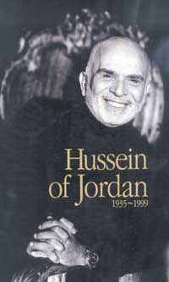
King Hussein of Jordan
1935- 1999
King 1953- 1999
Grandson of Abdullah, the first
king of Jordan. Educated in Egypt,
U.K. and U.S. Participated in 1967
War, but not 1973. Defeated early
challenges by Palestinians, finally
co-existing with the refugees. Did
not participate in 1990 war against
Iraq. “The great survivor” or “US puppet.” Died of cancer, succeeding in passing on the rule to his oldest son.
Notes:
King Hussein of Jordan
1935- 1999
King 1953- 1999
Grandson of Abdullah, the first
king of Jordan. Educated in Egypt, U.K. and U.S. Participated in 1967 War, but not 1973. Defeated early
challenges by Palestinians, finally co-existing with the refugees. Did not participate in 1990 war against
Iraq. Died of cancer, succeeding in passing rule on to his oldest son.

Slide 17
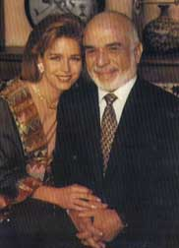
King Hussein and Queen Noor
Her autobiography is
titled “Leap of Faith.”
Notes:
King Hussein and Queen Noor.
She was his fourth wife, and the daughter of the CEO of Pan Am. Her grandfather was a Syrian Christian – she had not learned Arabic at home.

Slide 18
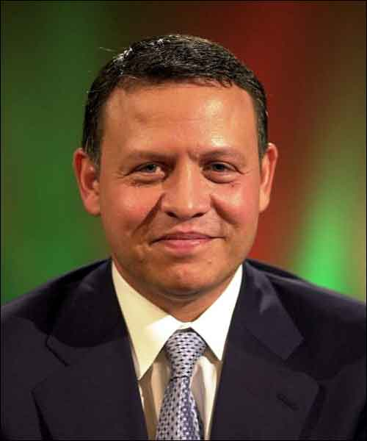
King Abdullah II of Jordan
Born 1962-
King 1999 –
Oldest son of King Hussein; mother
was Queen Mona (Toni Gardiner).
Had been head of Special
Forces; known for interest in
extreme sports. Educated in
U.K. and U.S. His father had
to maneuver to assure that
Abdullah succeeded to the
throne, instead of Hussein’s
brother. Married 1993 Queen Rania,
a Kuwaiti-born Palestinian.
Notes:
King Abdullah of Jordan
Born 1962-
King 1999 –
Oldest son of King Hussein. Has been head of Special Forces; known for interest in extreme sports. Educated in
U.K. and U.S. His father had to maneuver to assure that Abdullah succeeded to the throne, instead of Hussein’s
brother.

Slide 19
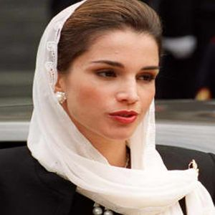
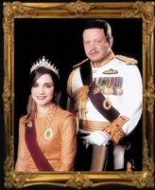
King Abdullah II and Queen Rania
The queen has a Bachelor’s degree from AUC, is fluent in English.
Upon graduation she worked for CITIBANK. She is active in several
charities, as well as working on upgrading IT in Jordan. She has given
talks in Dearborn, where she was warmly received.
The King and Queen have several children, assuring the reign.
Notes:
King Abdullah and Queen Rania
The queen has a Bachelor’s degree from AUC, is fluent in English.
She is active in several charities, as well as working on upgrading
IT in Jordan. She has given talks in Dearborn, where she was warmly
received.
The King and Queen have several children, assuring the reign.

Slide 20
Jordan: Real GDP/capita
Notes:
Jordan: Real GDP/Capita

Slide 21
Jordan: Inflation
Notes:
Jordan: Inflation

Slide 22
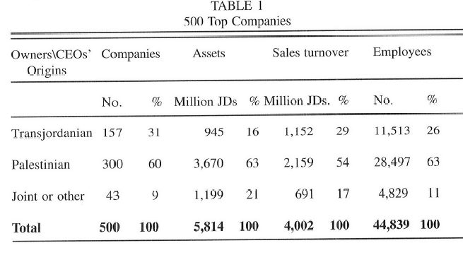
Jordan: Ownership of 500 Largest Companies, 1995
Source: Reiter (2004) “The Palestinian-Transjordanian Rift: Economic
Might and Political Power in Jordan,” Middle East Journal, W. 2004
Notes:
Jordan: Ownership of 500 Largest Companies, 1995

Slide 23
Foreign Aid to Jordan
Notes:
Foreign Aid to Jordan

Slide 24
Syria
Syria Chronology
http://www-personal.umd.umich.edu/~mtwomey/econhelp/444files/Syria_Dates.docx
Notes:
Syria Chronology
1516 area becomes part of Ottoman Empire
1920 France gets League of Nations mandate over Syria and Lebanon
1920s numerous demonstrations agains French presence
1946 Independence
1947 Ba’ath Party founded by Michel Aflaq and Salah-al-Din al-Bitar
1949, 1954 coups indicate political instability
1958-61 Syria and Egypt in United Arab Republic
1963 coup gives power to Ba’ath party. Discussions about union with Iraq end after a coup against the Ba’ath Party in Iraq
1967 Syrian participation in the Six day war against Israel leads to its loss of the Golan Heights
1970 Hafez Al Assad becomes president, representing (military and Ba’ath) against socialist Salah Jadid
1973 Syria participates in Yom Kippur War
1976 Syrian troops enter Lebanon, and is seen by the Muslim Brotherhood as supporting Christian side
1980 unsuccessful assassination attempt at Assad. Syria supports Iran in its war with Iraq.
1981 Israel annexed Golan Heights
1982 Syria suffers losses after Israeli invasion of southern Lebanon. Government attacks Muslim Brotherhood
1987 responding to international pressure, Syria closes training camps of Abu Nadal.
1990 Syria expands influence in Lebanon
1991 Syria supports U.S./international side in Gulf war against Iraq
2000 Hafez Al Assad dies, is succeeded by son Bashar
2004 Withdrawal of Syrian troops from Lebanon, but continues intervening there.

Slide 25
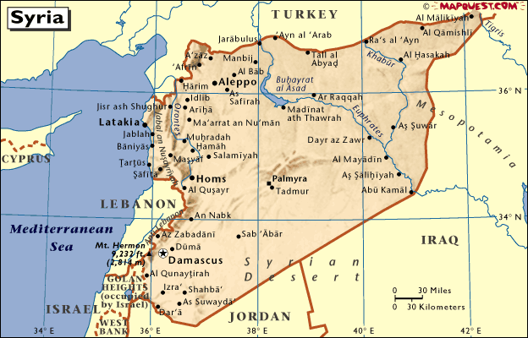
Map of Syria
Notes:
Map of Syria

Slide 26
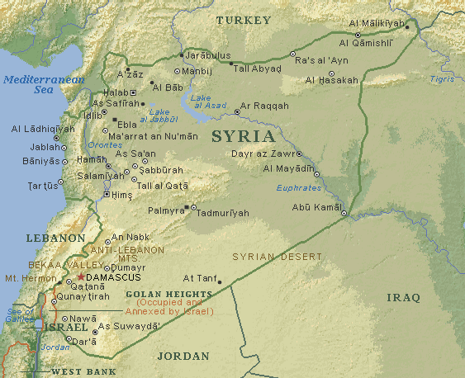
Map of Syria
Notes:
Map of Syria

Slide 27
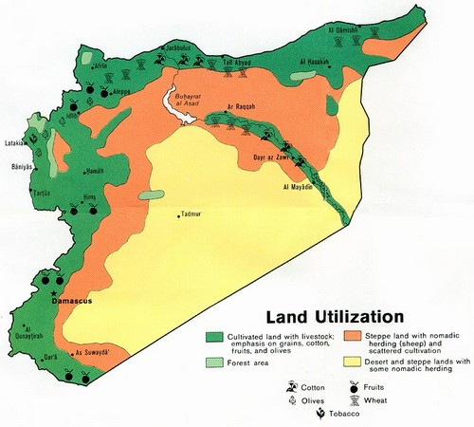
Syria: Land Utilization
Source: Juan Cole’s blog, December 2010
Notes:
Syria: Land Utilization

Slide 28
Population of Syria and Lebanon, 1930s. (1,000s)
Source: Hourani (1954)
Syria and Lebanon
p. 121
Notes:
Population of Syria and Lebanon, 1930s. Source: Hourani (1954) Syria and Lebanon p. 121

Slide 29
Syria: Population by Major Religious Groups. ~2000
Islam | 15,300,000 | 87%
Sunni | 12,600,000 | 72%
Shi’i | 700,000 | 4%
Alawite | 1,950,000 | 11%
Christians | 1,465,000 | 8.5%
Yazidism | 30,000 | 0.2%
Druze | 300,000 | 1.7%
Source estimates that 5-15% of Syrians are Kurds, another 5-15%
are Bedouin, and 1-5% are Turks.
Source: Encyclopedia of the Orient (online)
Notes:
Syria: Population by Major Religious Groups

Slide 30
Comparisons: year is 2002
Source: WDI
Notes:
Comparisons

Slide 31
Ba’th Party
The Ba’th (Ba’ath, Baath—Arabic for rebirth) party: pan-Arabic
party whose origins go back to 1930s movements against French
and British colonialism. Nationalist, populist, socialist, secular
and revolutionary. Party rejected Soviet Marxism, while supporting
land reform, public ownership in areas such as natural resources,
transport, large scale industry, and financial institutions.
Ba’th parties were formed in the 1940s, and came to power in
military coups in Syria and Iraq, both in 1963, where after
internal fighting, they were dominated by Hafez al-Assad and
Saddam Hussein, respectively.
The Ba’th movement has also had influence in Lebanon, Yemen,
Jordan, and Palestinian territories.
Notes:
Ba’th Party
The Ba’th (Ba’ath, Baath—Arabic for rebirth) party: pan-Arabic
party whose origins go back to 1930s movements against French
and British colonialism. Nationalist, populist, socialist, secular
and revolutionary. Party rejected Soviet Marxism, while supporting
land reform, public ownership in areas such as natural resources,
transport, large scale industry, and financial institutions.
Ba’th parties were formed in the 1940s, and came to power in
military coups in Syria and Iraq, both in 1963, where after
internal fighting, they were dominated by Hafez al-Assad and
Saddam Hussein, respectively.
The Ba’th movement has also had influence in Lebanon, Yemen,
Jordan, and Palestinian territories.

Slide 32
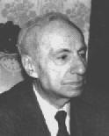
Early Leaders of Ba’th Movement
Michel Aflaq: 1910-1989
Born in Damascus to a middle class, Greek
Orthodox family. Educated at Sorbonne in Paris.
Was a school teacher, and briefly Minister of
Education. Supported union between Syria and
Egypt in 1958. Was forced to flee Syria, going to
Iraq, where he eventually received a token position
from Saddam Hussein
Salah Al Din Bitar (1912-1980) Born in Damascus into a
prominent family. Educated at the Sorbonne. Collaborated with
Michel Aflaq in forming Ba’th Party. Became a member of
parliament in 1954, and the first Ba’thist Prime Minister in
1963. Forced into exile in 1966, eventually to Paris, from where
he published material strongly critical of the Syrian government. Was
assassinated in Paris in 1980, presumably by the Syrian Government
Notes:
Michel Aflaq: 1910-1989
Born in Damascus to a middle class,Greek
Orthodox family. Educated at Sorbonne in Paris.
Was a school teacher, and briefly Minister of
Education. Supported union between Syria and
Egypt in 1958. Was forced to flee Syria, going to
Iraq, where he eventually received a token position
from Saddam Hussein.
Salah Al Din Bitar (1912-1980) Born in Damascus into a
prominent family. Educated at the Sorbonne. Collaborated with
Michel Aflaq in forming Ba’th Party. Became a member of
parliament in 1954, and the first Ba’thist Prime Minister in
1963. Forced into exile in 1966, eventually to Paris, from where
he publishes material strongly critical of the Syrian government. Was
assassinated in Paris in 1980, presumably by the Syrian Government.

Slide 33
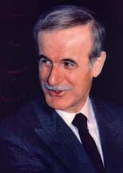
Hafez Al-Assad
1930-2000. Born in a small village to
a respected, if not wealthy family.
President 1971-2000
At 16 joined the Ba’th party. Studied
at a military academy. A member of
the Alawites, a small Shiite group, in a
predominantly Sunni country,
he had few natural allies. Participated
In a coup in 1963, slowly consolidated
power. He backed away from a pro-
Soviet stance late in his career. Did
not have a good relationship with
Iraq or Jordan. Lost Golan Heights.
Passed power to his son.
Notes:
Hafez Al-Assad
1930-2000.
President 1971-2000
Born in a small village to a respected, but not wealthy family.
At 16 joined the Ba’th party. Studied at a military academy. A member of the Alawites, a small Shiite group, in a
predominantly Sunni country, he had few natural allies. Participated In a coup in 1963, slowly consolidated Power. Competing with Salah Jadid, who was more socialist. He backed away from a pro-Soviet stance late in his career. Did not have a good relationship with either Iraq or Jordan. Lost Golan Heights.
Passed power on to his son.
Politics are described as more state capitalist than socialist, indicating the difference between him and Salah Jadid. Investment was dominated by the state. Significant reliance on aid.

Slide 34
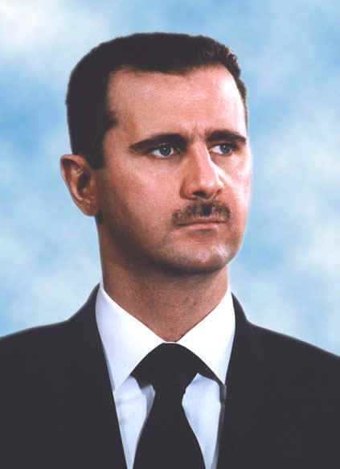
Bashar Al Assad
Born 1965
President 2000-
Studied ophthalmology in UK.
Returned to Syria in 1994 upon the
death of his brother, who was to be
king, but died in an accident. Married
Asm’al Akhras, daughter of a prominent
Syrian physician, who was raised in
England.
Some observers feel Bashar Al-Assad
does not have the appropriate personality
to rule.
Was a commander in the Syrian
Army before the death of his father.
Notes:
Bashar Al-Assad
Born 1965
President 2000-
Studied ophthalmology in UK. Returned to Syria in 1994 upon the death of his brother, who was to be king, but died in an accident. Bashar AL-Assad has been judged not the appropriate personality to rule. Was a commander in the Syrian Army before the death of his father.

Slide 35
Asma al-Assad: A Rose in the Desert Vogue Magazine. March, 2011.
Born 1975 in London. Her father is a doctor and her mother a diplomat. Spoke Arabic at home, and is also fluent in English. Worked as an investment banker, until marrying Bashar in 2000.
Has kept a rather low profile since the outbreak of Syria’s civil war, limiting herself to meeting war victims.
Vogue magazine has since withdrawn this article.
Notes:
Asma al-Assad: A Rose in the Desert
Born 1975 in London. Her father is a doctor and her mother a diplomat. Worked as an investment banker, until marrying Bashar in 2000.
Asma al-Assad is glamorous, young, and very chic—the freshest and most magnetic of first ladies. Her style is not the couture-and-bling dazzle of Middle Eastern power but a deliberate lack of adornment. She’s a rare combination: a thin, long-limbed beauty with a trained analytic mind who dresses with cunning understatement. Paris Match calls her “the element of light in a country full of shadow zones.” She is the first lady of Syria.
Vogue Magazine. March, 2011.

Slide 36
The Current Armed Violence in Syria
Spin-off from 2011 uprisings in Tunisia, Egypt, Yemen, Libya, became violent slowly.
Has led to over 100,000 deaths; UN claims 9,000,000 displaced, 2 m foreign refugees.
Economy’s decline may be over 40%.
Fighting over specific towns; Damascus remains pro-government. Some chemical
weapons have been used.
The opposition is an anti-Assad movement, and it can be seen as anti–Alawite. Many prominent Christians support the government, as do Iran, Hizbullah, and Iraq(?), assertedly because Alawites are closer to Shi’ites. Rebels looked stronger six months ago.
International Peace talks this week in Geneva. Pushed by Kerry (US), Lavrov (RU),
Davutoglu (Turkey), UN. Apparently will have participation of al-Assad’s gov’t,
many members of the opposition National Coalition, even as others resign, while a
separate war is developing among National Coalition groups and more radical
factions (ISIS, JAN) who many see as being non-Syrians with foreign funding.
Notes:
The Current Armed Violence in Syria.
Spin-off from uprisings in Tunisia, Egypt, Yemen, Libya, became violent slowly…
Has led to over 100,000 deaths; UN claims 9,000,000 displaced, 2 m foreign refugees.
Economy’s decline may be over 40%.
Fighting over specific towns; Damascus remains pro-government. Some chemical
weapons have been used.
The opposition is an anti-Al-Assad movement, so it can be seen as anti–Alawite. Many prominent Christians support the government, as does Iran and Iraq and Hizbullah, assertedly because Alawites are closer to Shi’ites. Rebels looked stronger six months ago.
International Peace talks this week in Geneva. Pushed by Kerry (US), Lavrov (RU),
Davutoglu (Turkey), UN. Apparently will have participation of al-Assad’s gov’t,
many members of the opposition National Coalition, even as others resign, while a
separate war is developing among National Coalition groups and more radical
factions (ISIS, JAN) who many see as being non-Syrians with foreign funding.

Slide 37
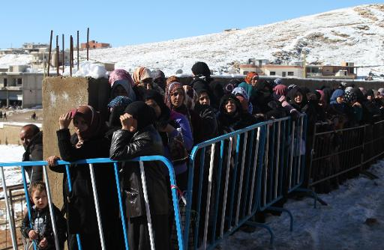
842,000 Syrian refugees in Lebanon (pop.: 4.4 mn) as UN Calls for $6 bn Aid
Syrian families queue in the snow to be registered by the United Nations High Commissioner for Refugees (UNHCR) on December 15, 2013 in the Arsal refugee camp in the Lebanese Bekaa valley. One of five people living in Lebanon are refugees who have fled the conflict in neighbouring Syria, the United Nations High Commissioner for Refugees said Monday.
An additional 52,000 Palestinians who were living in Syria have also taken refuge in Lebanon, the UN's refugee agency said.
The UNHCR figures do not include hundreds of thousands of Palestinian refugees who have been living in Lebanon for decades, most of them in insalubrious camps across the country.
Source: Juan Cole’s Blog, Dec. 21, 2013

Slide 38
Syria: Real GDP/capita
Notes:
Syria: real GDP/capita

Slide 39
Syria: Rate of Growth of Real GDP/Capita
Notes:
Syria: Rate of Growth of Real GDP/Capita

Slide 40
Syria: Inflation
Source: WDI
Notes:
Syria: Inflation

Slide 41
Lebanon
Notes:
Lebanon

Slide 42
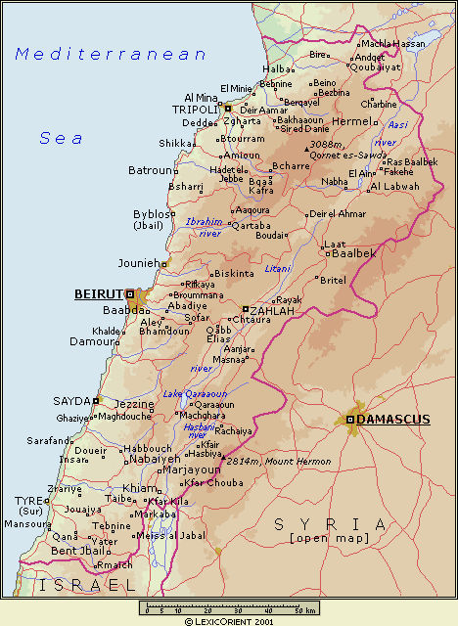
Map of Lebanon
Notes:
Map of Lebanon

Slide 43
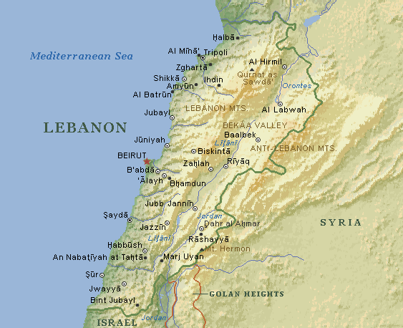
Map of Lebanon
Notes:
Map of Lebanon

Slide 44
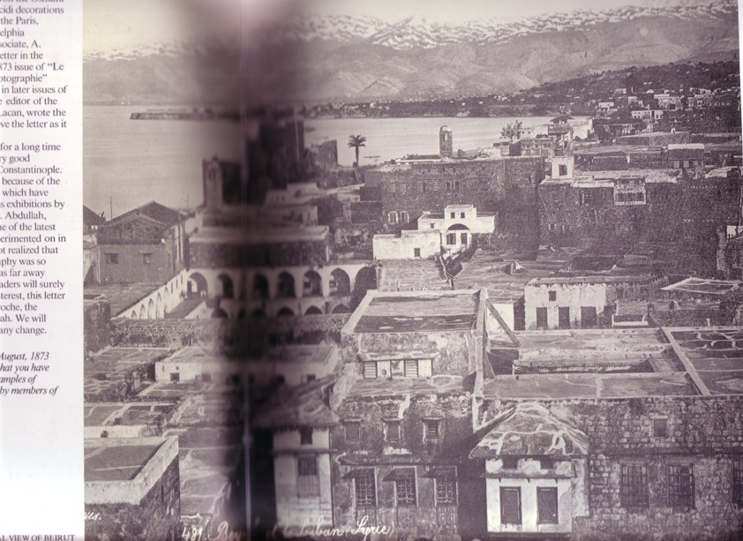
Beirut, ~1870
Source: Cizgen, Photography in the Ottoman Empire page 80
Notes:
Beiru, ~1879
Source: Cizgen, Photography in the Ottoman Empire TR 111 C58 1987 Page 80

Slide 45
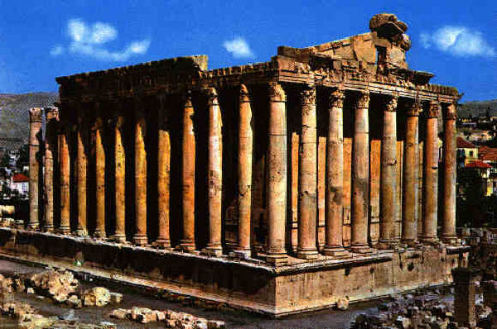
Baalbek. Roman ruins in the Bekaa valley
Notes:
Baalbek

Slide 46
Lebanon Chronology
http://www-personal.umd.umich.edu/~mtwomey/econhelp/444files/Lebanon_Dates.docx
Notes:
Lebanon chronology
7th century: Arab conquest, who govern from Damascus
11th century Crusades
Late 12th century; muslim reconquest, directed from Egypt
16th century, Ottoman Turks
1850s civil wars, in which a religious content (Druze/(other)Moslems/Christians) is important. Many Christian Lebanese emigrate to the Americas
post WWI- French mandate (Lebanon, Syria, Antakya of present day Turkey), as Greater Lebanon. Political power divided among Shi’is, Sunnis and Christians, with French favoring Maronite Christians.
1943/45 Independence, National Covenant maintained.
late 1940s; although Lebanon took little part in wars against newly established Israel, it was affected by settlement of Palestinian refugees
1958 civil strife as Lebanon’s pro-Western policies were challenged: US Marines intervene
1967, 1973 Lebanon formally is not involved with Arab wars against Israel.
1975 civil war (until 1989); Muslims, PLO, Christians (Maronite, Phalange), with subsequent interventions from Israel, Syria, US, France.
1976 Syrian troops enter Lebanon.
1978 Israel invades southern Lebanon. UN Peacekeeping mission in southern Lebanon
1982 Israel again invades Lebanon, forcing relocation of PLO headquarters. Massacre of Palestinians by Lebanese Christians during Israeli occupation leads to multinational peacekeeping mission. Amin Gemayel (Christian) elected president. Phalangists slaughter 1000 Palestinian refugees in camps in Sabra and Chatila in west Beirut.
1983 terrorist bombing of US and French troops
1988-89 conflict about the successor to president, Amin Gemayel, who had appointed Michel Aoun as interim president, but others pushed Elias Hrawi. Hrawi eventually dominated, and signed a treaty that gave Syria dominance in Lebanon’s foreign relations.
1989 Ta’if (located in Saudi Arabia) Accords lead to ending of Civil War.
1992 Rafik Hariri elected Prime Minister, technocratic approach, rebuilds Beirut.
2005 Hariri dies in a car bomb. Leads to Anti-Syrian riots.
2006 Israel attacks, inflicting destruction of much infrastructure.

Slide 47
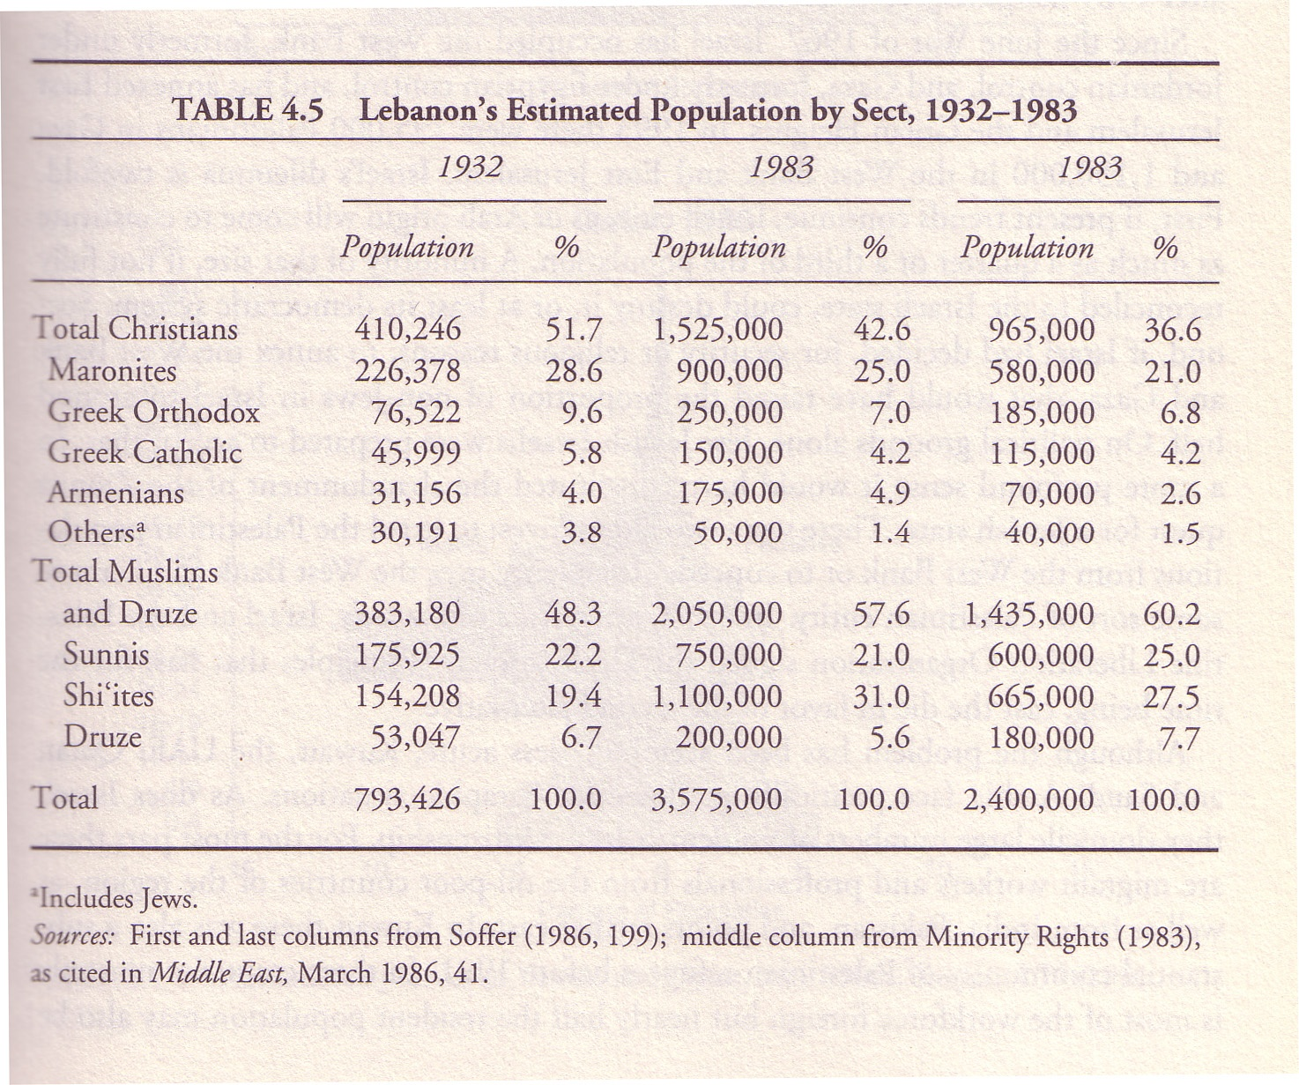
R&W Table 4.5 page 96 Lebanon’s Population by Sect, 1932-1983
Notes:
R&W Table 4.5 page 96 Lebanon’s Population by Sect, 1932-1983
Differential fertility. Lebanon and Israel. Shiites and Sunnis. Ashkenazi and Sephardim. Turks and Kurds.

Slide 48
Population of Syria and Lebanon, 1930s. (1,000s)
Although this listing has
slightly more Moslems,
the previous listing (from
R&W) has a few more
Christians in Lebanon.
Source: Hourani (1954)
Syria and Lebanon
p. 121
Notes:
Population of Syria and Lebanon, 1930s. Source: Hourani (1954) Syria and Lebanon p. 121

Slide 49
Lebanon: Population by Religious Groups. ~2000
Islam | 2,000,000 | 54%
Shi’i | 1,200,000 | 32%
Sunni | 750,000 | 20%
Alawite | 50,000 | 1.4%
Christians | 1,450,000 | 39%
Maronites | 850,000 | 23%
Melkite | 400,000 | 11%
Other | 45,000 | 1.3%
Druze | 210,000 | 5.7%
Baha’i | 4,000 | 0.1%
Source: Encyclopedia of the Orient
Notes:
Lebanon: Population by Religious Groups

Slide 50
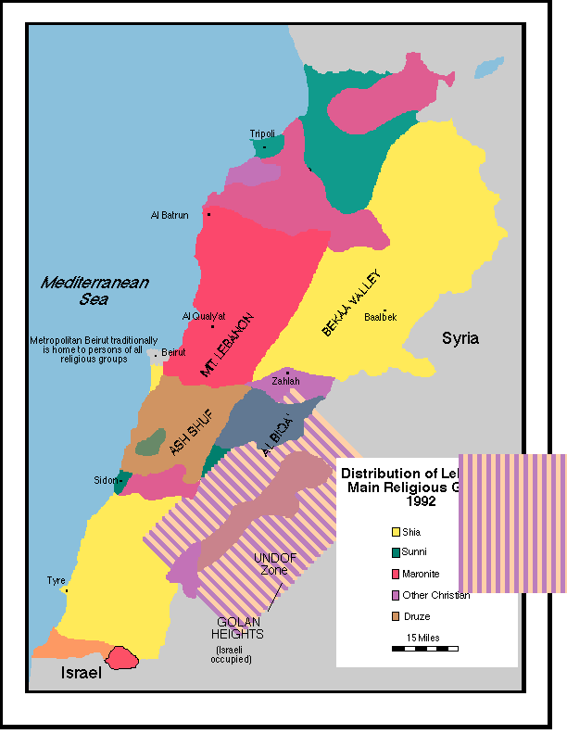
Lebanon: Distribution of Main Religious Groups, 1992
Notes:
Lebanon: Distribution of Main Religious Groups, 1992

Slide 51
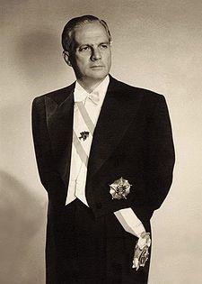
Camille Chamoun, 1900-1987
President 1952-58.
Educated in France, became a lawyer.
Elected to the Lebanese parliament in 1934.
Active in movement for independence from
France. Elected to replace B. el-Khoury, who
resigned due to graft. Chamoun was threatened
at the end of his term by Muslim groups allied
with Nasser, and he appealed to Eisenhower,
who sent in the Marines in 1958.
Stayed active politically through the Civil
War, until his death.
Notes:
Camille Chamoun, 1900-1987 . President 1952-58.
Educated in France, became a lawyer.
Elected to the Lebanese parliament in 1934.
Active in movement for independence from
France. Elected to replace B. el-Khoury, who
resigned due to graft. Chamoun was threatened
at the end of his term by Muslim groups allied with
Nasser, and he appealed to Eisenhower, who
sent Marines.

Slide 52
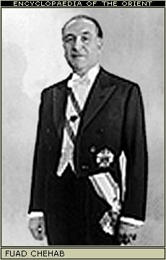
Fuad Chehab (Shihab) 1902-1973
President 1958-1964
Born to a Maronite Christian family.
Joined military at a young age. Served
with the French in Syria in 1920s.
Becomes President in 1958, resolving
armed conflict over Lebanon’s orientation, in which US troops intervened, on side of pro-western, Christians, over Muslims.
Was well regarded for honesty and modernization efforts, but his talk of meritocracy was suspected of favoring Christians. Refused to let himself be re-elected.
Notes:
Fuad Chehab
President 1958-1964
Born to a Maronite Christian Family
Joined military at a young age. Served
with the French in Syria in 1920s.
Becomes President in 1958, resolving
armed conflict over Lebanon’s orientation, in which US troops intervened, on side of pro-western, anti-Nasserist, Christian over Muslim.
Was well regarded for honesty and modernization efforts, but his talk of meritocracy was suspected of favoring Christians. Refused to let himself be re-elected.

Slide 53
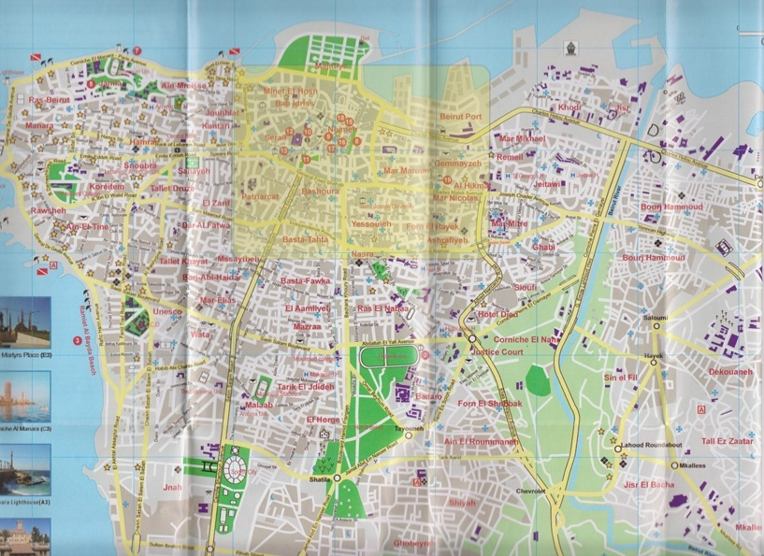
Notes:
Solidere area in Beirut

Slide 54
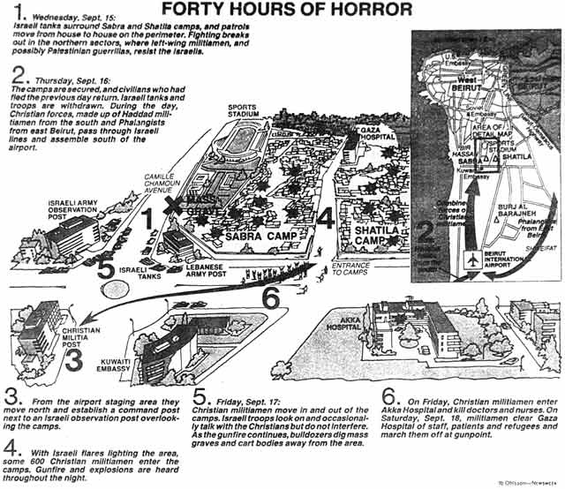
Sabra Shatila massacre
750 – 3,000 killed
http://www.geocities.com/cahumanity/maps/index.html#massacremap no longer works.
Notes:
Sabra Shatila massacre September, 1982. Between 750 and 3,000 people died.
(my initial link no longer works: I believe it was Newsweek.)
Background: Lebanon became the base of operations of the PLO after their 1970 expulsion from Jordan – there were many Palestinian refugees in various camps in Lebanon, where their economic and political participation was severely restricted. Early in 1982, Israeli forces led by Ariel Sharon invaded Lebanon, attempting to defeat the PLO. At the request of the Lebanese government, a multinational (US, UK, France, Italy) peace-keeping force was stationed there in mid-1982 to oversee the withdrawal of the PLO, to Tunisia. The multinational forces were in the process of reducing their own vigilance when, on September 14, newly elected President Bashir Gemayel – a Maronite Christian – was assassinated, which the Lebanese ‘street’ blamed on Palestinians, and perhaps Shi’a.
Wednesday September 15
Israeli tanks surround Sabra and Shatila camps, and patrols move from house to house on the perimeter. Fighting breaks out in the northern sectors, where left-wing militiamen, and possibly Palestinian guerrillas, resist the Israelis.
Thursday Sept. 16: The camps are secured, and civilians who had fled the previous day return. Israeli tanks and troops are withdrawn. During the day, Christian forces, made up of Haddad militiamen from the south and Falangists from east Beirut, pass through Israeli lines and assemble south of the airport.
From the airport staging area thy move north and establish a command post next to an Israeli post overlooking the camps.
With Israeli flares lighting the area, some 600 Christian militiamen enter the camps. Gunfire and explosions are heard throughout the night.
Friday, Sept. 17
Christian militiamen move in and out of the camps. Israeli troops look on an occasionally talk with the Christians but do not interfere. As the gunfire continues, bulldozers dig mass graves and cart bodies away from the area.
On Friday, Christian militiamen enter Akka Hospital and kill doctors and nurses. On Saturday, Sept. 18, militiamen clear Gaza hospital of staff, patients and refugees and march them off at gunpoint.
A UN commission concluded in 1983 that Israel bore responsibility for this violence, because Isralei forces controlled these camps. The word genocide was used, and debated. An Israeli commission, led by Chief Justice Yitzhak Kahan, described Israel as indirectly responsible, and called for Sharon’s resignation, which he eventually did.
\SabraShatila

Slide 55
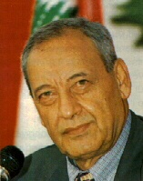
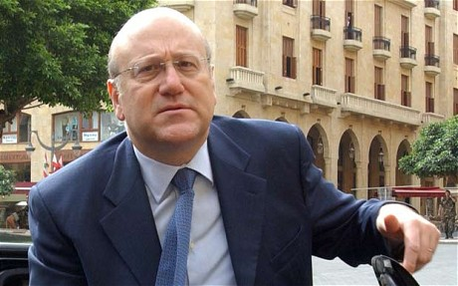
Lebanon’s 2013 Leaders
Najib Mikati (1955-)
Sunni, said to be the
richest man in Lebanon.
Studied at AUB and
at Harvard. Prime Minister
until March, 2013. P.M.
designate is Tammam
Salam.
Michel Suleiman (1948-)
President since 2008.
Christian, ex-military,
known for keeping
the army out of
sectarian politics.
Nabih Berry (1938-)
Speaker of House since
1992. Shi’ia. Said to
be Syrian ally and link
to Hizbullah.
Lived in U.S.
Notes:
Link to Lebanon’s Current 2011 Leaders

Slide 56
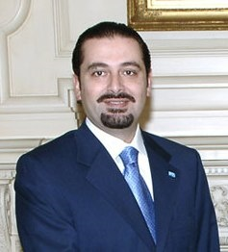
Lebanon’s 2010 Leaders
Saad Hariri (1970-)
Son of assassinated
Rafiq Hariri; his mother
is Saudi. Studied
business at Georgetown.
Leader of March14
(anti-Syrian), predominantly
Sunni group.
Michel Sleiman (1948-)
President. Christian.
Ex-military, known
for keeping army
out of sectarian
politics.
Nabih Berry (1938-)
Speaker of House since
Shi’ia. Said to be
Syrian ally and link to
Hizbullah.
Lived in U.S.
http://www.lebanonembassyus.org/Kids/Facts.htm
Notes:
Link to Lebanon’s Current 2010 Leaders

Slide 57
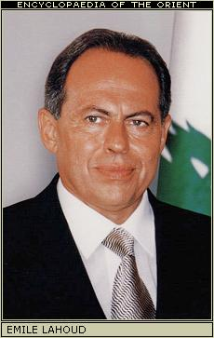
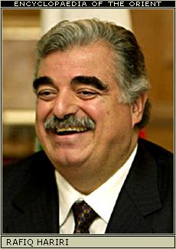
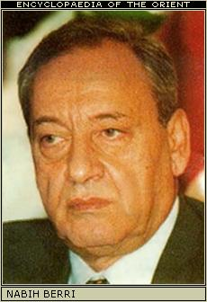
Those who governed Lebanon (2003)
Emile Lahoud, 1936-
President.
Rafiq Hariri, 1944-05
Prime Minister
Sunni. Technocrat.
Wealth came from
construction in S.A.
Assassinated.
Nabih Berri, 1938-
Notes:
Those who governed Lebanon (2003)

Slide 58
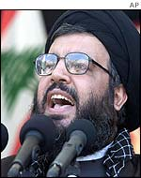
Hizbullah. (Hizb Allah) – the Party of God
Political organization which coalesced in 1982, following early leadership from Imam Musa Sadr (disappeared in Libya in 1978).
Predominantly Shi-a, it became a power in Lebanese Parliament (w/ Amal). Effective military presence against Israel, and against troops from US and France. Strongly opposed
Sheikh Nasrallah
by certain sectors of Lebanese society. Receives money and inspiration from Iran. Provides a range of social, health, and community services, especially in southern Lebanon and southern Beirut—Shi’a strongholds. The kidnapping of some Israeli troops in July 2006 led to the attack by Israel; Hizbullah’s ability to hold them off gained them much support in Lebanon and throughout the Arab world. The resolution of Suleiman’s presidential succession, and Hariri-Mikati are considered to have been determined by Hizbullah.
http://almashriq.hiof.no/lebanon/300/320/324/324.2/hizballah/
Notes:
Hizbullah
Political organization which coalesced in 1982, following early leadership from Imam Musa Sadr (disappeared in Libya in 1978).
Predominantly Shi-a, is a power in Lebanese Parliament (Amal). Effective military presence against Israel, and against troops from US and France. Strongly opposed by certain sectors of Lebanese society. Receives money and inspiration from Iran. Provides a range of social, health, and community services, especially in southern Lebanon and southern Beirut—Shi’a strongholds. The kidnapping of some Israeli troops in July 2006 led to the attack by Israel; Hizbullah’s ability to hold them off gained them much support in Lebanon and throughout the Arab world.

Slide 59
From M. Dick (2010), “Hizballah’s Domestic Growing Pains”
While Hizballah has not used the last five years to coopt the entirety
of the Shi‘i population, it continues to cultivate its core constituency.
The large-scale and usually efficient provision of social services to
the public is a pillar of Hizballah’s drive to gain the support of the
majority of the Shi‘a. The party provides schools, medical facilities,
agricultural assistance and support for widows and orphans. But
Hizballah has been unable to secure the Health, Education or Social
Affairs Ministries in the three governments formed since Syria’s…
…Whether or not Hizballah prefers to engage in domestic politics is
irrelevant; it is under pressure to perform from its core constituency
and the system, even if matters are supposedly deadlocked. Prior to
2005, Syria’s presence could be blamed for postponing a decision on,
for example, how to reform the moribund state bureaucracy, but this
excuse is fading…
Notes:
From M. Dick (2010), “Hizballah’s Domestic Growing Pains”
While Hizballah has not used the last five years to coopt the entirety
of the Shi‘i population, it continues to cultivate its core constituency.
The large-scale and usually efficient provision of social services to
the public is a pillar of Hizballah’s drive to gain the support of the
majority of the Shi‘a. The party provides schools, medical facilities,
agricultural assistance and support for widows and orphans. But
Hizballah has been unable to secure the Health, Education or Social
Affairs Ministries in the three governments formed since Syria’s…
…Whether or not Hizballah prefers to engage in domestic politics is
irrelevant; it is under pressure to perform from its core constituency
and the system, even if matters are supposedly deadlocked. Prior to
2005, Syria’s presence could be blamed for postponing a decision on,
for example, how to reform the moribund state bureaucracy, but this
excuse is fading…

Slide 60
Rafik Hariri murder trial begins at The Hague
BBC: 16 January 2014
The trial of four men accused of murdering former Lebanese PM Rafik Hariri has begun at an unprecedented tribunal at The Hague.
The four - alleged associates of the Syria-backed militant Shia movement Hezbollah - have not been arrested and are being tried in absentia.
Hariri and 21 others were killed by a massive car bomb in Beirut in 2005.
The killings polarised Lebanon and led to the withdrawal of Syrian troops. Hezbollah denies any involvement.

Slide 61
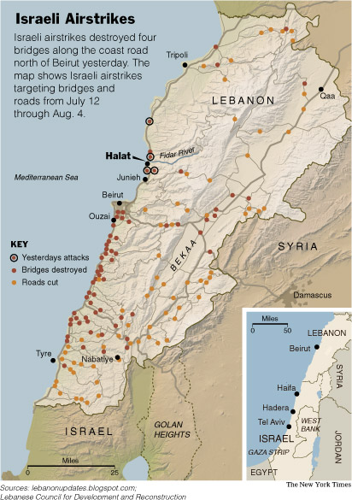
Lebanon: Israeli airstrikes
July 12 through Aug. 4, 2006
Source: New York Times,
August 5, 2006
Notes:
Lebanon: Israeli airstrikes

Slide 62
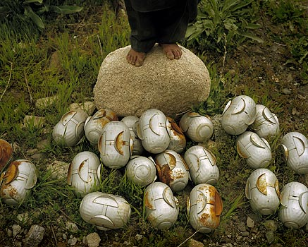
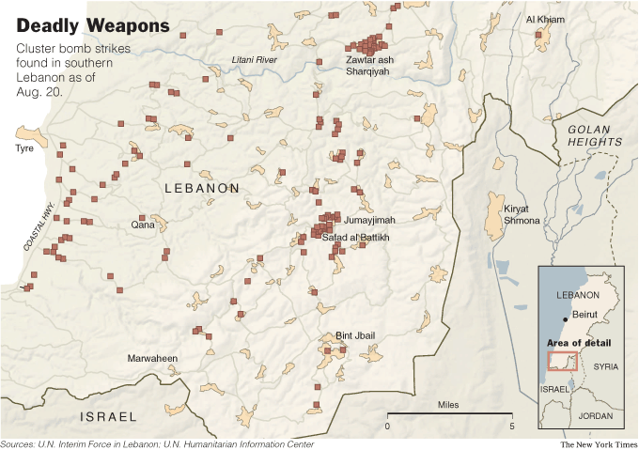
Cluster bombs in southern Lebanon
Map Source New York Times August 25, 2006
Notes:
Cluster bombs in southern Lebanon

Slide 63
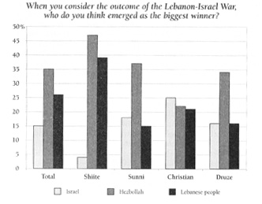
Post-war Attitudes (1)
Source: Telhami (2007) “Lebanese Identity and Israeli Security in
the Shadows of the 2006 War,” Current History
Notes:
Post-War Attitudes (1).
Source: Telhami (2007) “Lebanese Identity and Israeli Security in
the Shadows of the 2006 War,” Current History

Slide 64
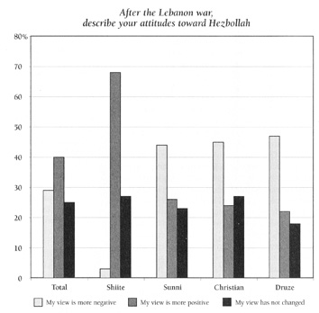
Post-War Attitudes (2)
Source: Telhami (2007) “Lebanese Identity and Israeli Security in
the Shadows of the 2006 War,” Current History
Notes:
Post-War Attitudes (2)
Source: Telhami (2007) “Lebanese Identity and Israeli Security in
the Shadows of the 2006 War,” Current History

Slide 65
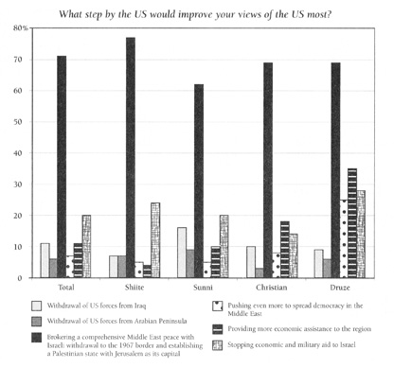
Post-war Attitudes (3)
Source: Telhami (2007) “Lebanese Identity and Israeli Security in
the Shadows of the 2006 War,” Current History
Notes:
Post-war Attitudes (3)
Source: Telhami (2007) “Lebanese Identity and Israeli Security in
the Shadows of the 2006 War,” Current History

Slide 66
Lebanon: Real GDP/capita
Notes:
Lebanon: real GDP/Capita

Slide 67
Lebanon: Inflation
Inflation was over 400% in 1987. Moreover, it could not be measured
during the mid-1970s, due to internal violence.
Notes:
Lebanon--inflation

Slide 68
Questions about Syria and Lebanon e-mailed to mt from a journalist based in Beirut (~2004)
1.What's the total amount of annual trade between the two countries? 2. What are the main products traded? What are the biggest imports and exports for both countries? 3. Has trade increased or decreased in recent years? By how much? 4. Which of the two countries benefits the most from trade? Why? 5. How (if at all) will new diplomatic relations help trade between the two countries? 6. What are the main obstacles to trade between Syria and Lebanon? 7. How do the US sanctions on Syria hurt trade between the countries? 8. What about bureaucracy? Does that hinder trade? 9. In your opinion, what are the most important things that need to happen for Syria and Lebanon to improve their economic relationship? 10. How important is illegal trade between the two countries, and why aren't there more attempts to regulate it?

Slide 70
Lebanon: Land Use
Notes:
Lebanon: Land Use

Slide 71
Lebanon: Agricultural Output
Notes:
Lebanon: Agricultural Output (FAO)

Slide 72
Jordan: Land Use
Notes:
Jordan: Land Use

Slide 73
Jordan: Agricultural GDP
Notes:
Jordan: Agricultural GDP (WDI)

Slide 74
Syria: Land Use
Notes:
Syria: Land Use (WDI)

Slide 75
Syria: Agricultural GDP
Notes:
Syria: Agricultural GDP

Slide 76
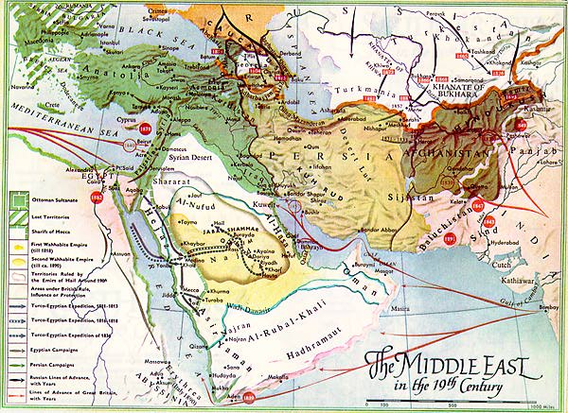
Map of 19th Century Middle East
Notes:
Map of 19t century Middle East

Slide 77
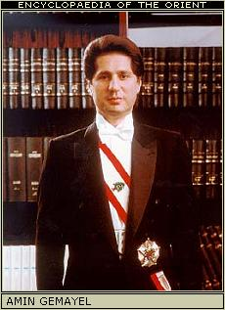
Amin Gemayel
Born: 1942, near Beirut
President 1982-88
Maronite Christian. Father founded
the Phalange Party, which allied
with Israel. His brother (then President)
was assassinated. Amin also ruled during
a time of severe violence—Syria in
the north, Israel to the south, US, France,
And confessional violence inside the
country.
Son assassinated November, 2006
Notes:
Amin Gemayel
Born: 1942
President 1982-88

Slide 78
Pierre Gemayel
Killed by unknown assassins (many think from Syria) in November, 2006
Was a cabinet minister. His father (Amin Gemayel) had been president,
and an uncle (Bashir Gemayel) was assassinated in 1982. His grandfather
a Maronite Christian, founded the Phalangist Party.
Notes:
Pierre Gemayel
Killed by unknown assassins (many think from Syria) in November, 2006
Was a cabinet minister. His father (Amin Gemayel) had been president,
and an uncle (Bashir Gemayel) was assassinated in 1982. His grandfather
a Maronite Christian, founded the Phalangist Party.

Slide 79
Michel Suleiman 1948-
Maronite Christian. Studied in Lebanon’s
military academy. Extensive military career.
Is widely discussed (end of 2007) as the
candidate for President – replacing Lahoud,
but major political leaders can’t seem to
agree on the details.
One alternative for President was
Michel Aoun – also a Christian, military
leader who had confronted Syria, and lived
in exile for 15 years.
Notes:
Michel Suleiman 1948-
Studied in Lebanon’s miliatry academy.
Extensive military career.
Is widely discussed candidate for
President –replacing Lahoud, but major
political leaders can’t seem to agree on
the details.

Slide 80
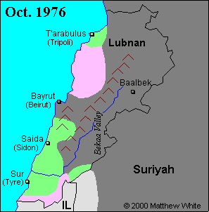
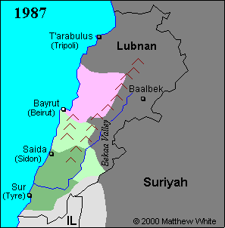
Divisions of Lebanon, 1976 and 1987
Dark gray is Syria, light gray is Israel. Pink is Christian-Maronite.
Bright green is Moslem; darker green is Shiite, pale green is Druze
Notes:
Divisions of Lebanon, 1976 and 1987

Slide 81
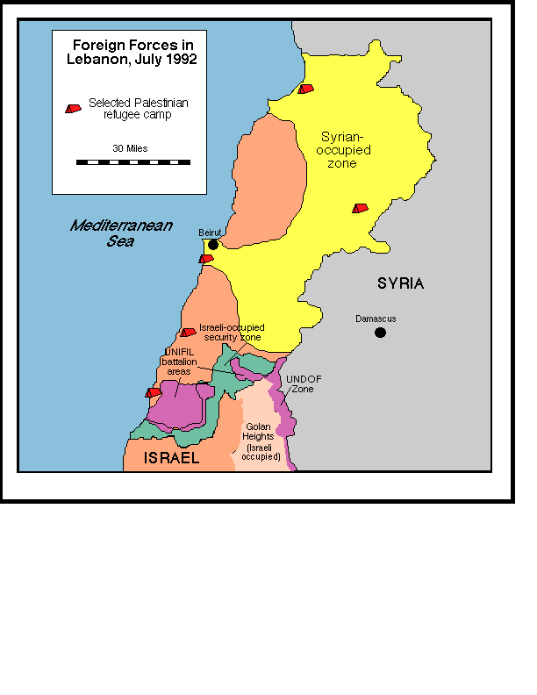
Foreign Forces in Lebanon, 1992
Notes:
Foreign Forces in Lebanon, 1992

Slide 82
Ottoman Administrative Divisions
Also showing railroad
Source: Wilson, King Abdullah, Britain and the making of Jordan
Notes:
Ottoman Administrative Divisions. Showing railroad
Source: Wilson, King Abdullah, Britain and the making of Jordan

Slide 83
Transjordan and Palestine
Source: Wilson, King Abdullah, Britain and the making of Jordan
Notes:
Transjordan and Palestine

Slide 84
Jordan’s Current Account
Link to JordanBoP
Notes:
Jordan’s Current Account

